Slide 1
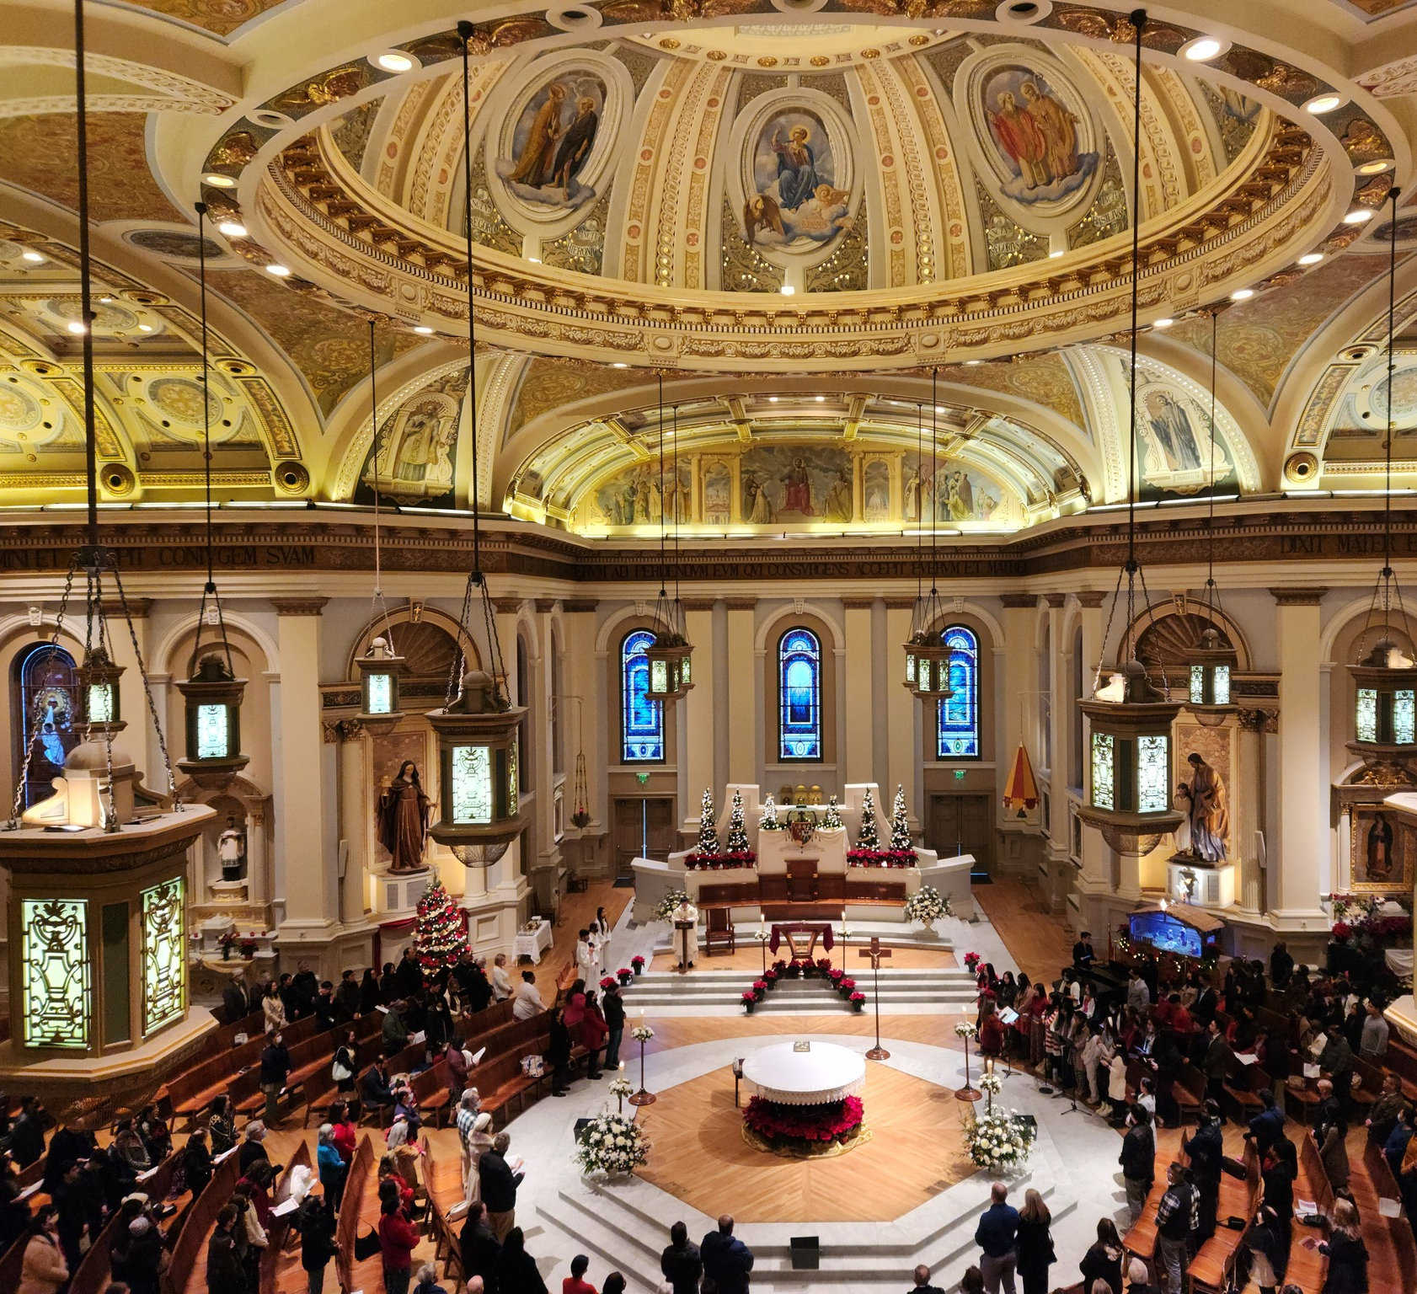
Liturgical Renewal PARISH MUSICIAN WORKSHOP
Renewed at the Table of the Lord
March, 2026
Notes:
--- Image source: Microsoft 365 content library

Slide 2
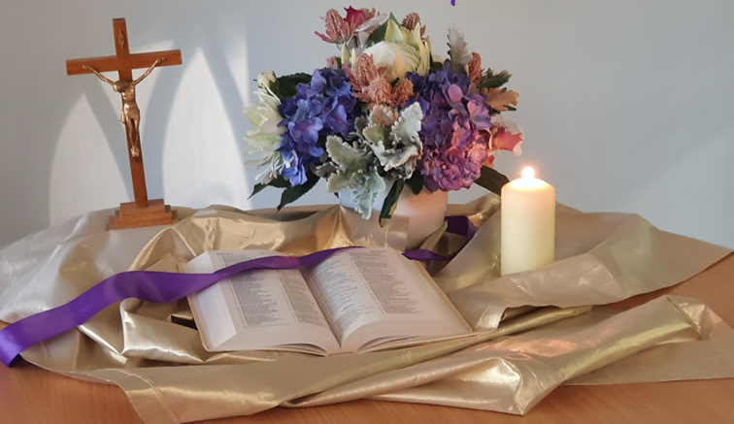
ACTIVITY
Opening Prayer
Scripture: Matthew 20: 25-28
But Jesus summoned them and said, “You know that the rulers of the Gentiles lord it over them, and the great ones make their authority over them felt.
But it shall not be so among you. Rather, whoever wishes to be great among you shall be your servant; whoever wishes to be first among you shall be your slave.
Just so, the Son of Man did not come to be served but to serve and to give his life as a ransom* for many.”
Notes:
“This is not a standalone initiative. It’s one strand of how we live the pastoral plan—specifically the priority of Worship.”

Slide 3
ACTIVITY
Activity
Share one word or phrase that describes how you feel when you walk into church for Mass?
Notes:
“This is not a standalone initiative. It’s one strand of how we live the pastoral plan—specifically the priority of Worship.”

Slide 4
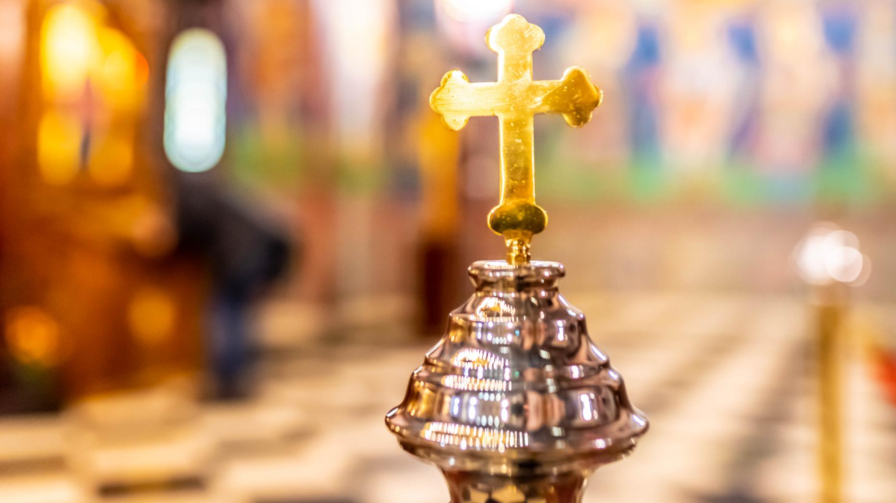
Liturgical renewal is a diocesan effort to deepen spiritual renewal by helping our people more fully, consciously, and actively participate in the Mass—the source and summit of our life together.
Why Liturgical Renewal — in one sentence
Notes:
--- The diocesan initiative for liturgical renewal aims to deepen the spiritual life of parishes by fostering authentic participation in the sacred liturgy over a two-year period. This plan is rooted in the Church’s call for ongoing renewal, emphasizing reverence, beauty, and active engagement with the Eucharist as the source and summit of Christian life. The objectives include strengthening catechesis on liturgical theology, enhancing the quality of celebrations, and equipping clergy and lay ministers with resources to lead renewal efforts effectively. By focusing on seasonal phases aligned with the liturgical calendar, the plan ensures that renewal is not a one-time event but a sustained journey of formation and transformation. Key goals include improving homiletic quality, promoting sacred music that reflects the Church’s tradition, and fostering a culture of prayerful preparation among ministers and congregations. This vision also addresses pastoral challenges such as balancing tradition with accessibility, ensuring inclusivity while maintaining doctrinal integrity, and responding to cultural diversity within the diocese. Ultimately, the renewal seeks to inspire a deeper encounter with Christ through the liturgy, strengthening parish identity and unity across communities. Image source: Microsoft 365 content library

Slide 5
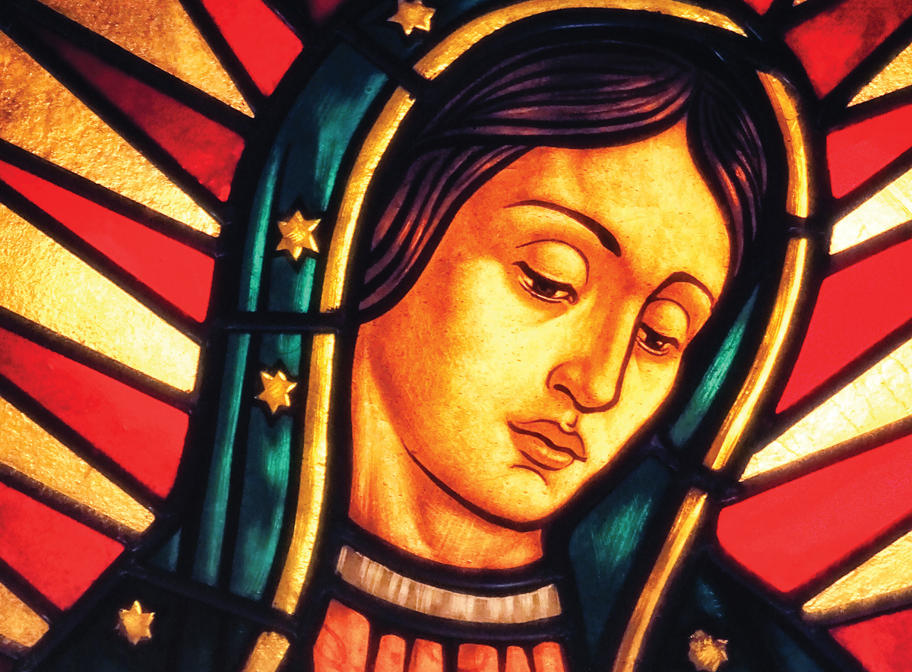
Spiritual and Pastoral Frames
EUCHARIST – The Eucharist as the “source and summit” of Christian life
ASSEMBLY – Vatican II called all members of the assembly to actively participate in the liturgy
UNITY – Our Lady of Guadalupe gathers us as ONE family leads us to Christ
Notes:
The diocesan initiative for liturgical renewal aims to deepen the spiritual life of parishes by fostering authentic participation in the sacred liturgy over a two-year period. This plan is rooted in the Church’s call for ongoing renewal, emphasizing reverence, beauty, and active engagement with the Eucharist as the source and summit of Christian life. The objectives include strengthening catechesis on liturgical theology, enhancing the quality of celebrations, and equipping clergy and lay ministers with resources to lead renewal efforts effectively. By focusing on seasonal phases aligned with the liturgical calendar, the plan ensures that renewal is not a one-time event but a sustained journey of formation and transformation. Key goals include improving homiletic quality, promoting sacred music that reflects the Church’s tradition, and fostering a culture of prayerful preparation among ministers and congregations. This vision also addresses pastoral challenges such as balancing tradition with accessibility, ensuring inclusivity while maintaining doctrinal integrity, and responding to cultural diversity within the diocese. Ultimately, the renewal seeks to inspire a deeper encounter with Christ through the liturgy, strengthening parish identity and unity across communities. Image source: Microsoft 365 content library

Slide 6

LITURGICAL RENEWAL IS PART OF The Diocesan Journey
Help clergy, liturgical ministers, and parishioners experience liturgical renewal as one key strand within spiritual renewal on our Journey to 2031, not “one more change.”
How and why we celebrate the Mass is one of the primary ways we live this broader journey of renewal.
The Mass celebration nourishes vibrant faith.
The Eucharist compels us to evangelize through actions and words.
Supports the Pastoral Plan Priority of Worship and its objectives that focus on understanding the Mass, joyful music, helpful homilies, and a sense of being generously welcomed.

Slide 7
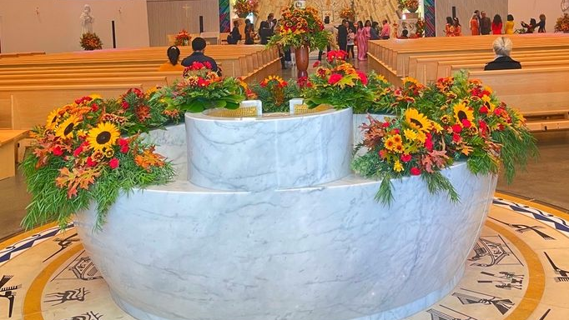
LITURGICAL RENEWAL WILL
Provide a two-year diocesan catechesis on the Mass that promotes a greater understanding of the Mass
Promote greater unity in how the Mass is celebrated across the Diocese of San José,
Clarify and reinforce the GIRM rubrics and diocesan practices where there is discretion.
SO THAT ALL MAY EXPERIENCE:
Deepening love for the Mass.
Strengthening full, conscious, and active participation.
Connecting Sunday worship to daily life and mission.
Notes:
--- The diocesan initiative for liturgical renewal aims to deepen the spiritual life of parishes by fostering authentic participation in the sacred liturgy over a two-year period. This plan is rooted in the Church’s call for ongoing renewal, emphasizing reverence, beauty, and active engagement with the Eucharist as the source and summit of Christian life. The objectives include strengthening catechesis on liturgical theology, enhancing the quality of celebrations, and equipping clergy and lay ministers with resources to lead renewal efforts effectively. By focusing on seasonal phases aligned with the liturgical calendar, the plan ensures that renewal is not a one-time event but a sustained journey of formation and transformation. Key goals include improving homiletic quality, promoting sacred music that reflects the Church’s tradition, and fostering a culture of prayerful preparation among ministers and congregations. This vision also addresses pastoral challenges such as balancing tradition with accessibility, ensuring inclusivity while maintaining doctrinal integrity, and responding to cultural diversity within the diocese. Ultimately, the renewal seeks to inspire a deeper encounter with Christ through the liturgy, strengthening parish identity and unity across communities. Image source: Microsoft 365 content library

Slide 8
TIMELINE FOR LITURGICAL RENEWAL
Lent 2026
Introductory Rite
Fall 2026
Liturgy of the Word
Lent/Easter 2027
Liturgy of Eucharist
Fall 2027
Communion and Concluding Rites
Notes:
The two-year arc is structured around four major phases corresponding to key liturgical seasons: Lent 2026, Fall 2026, Lent/Easter 2027, and Fall 2027. Each phase builds upon the previous, creating a rhythm of catechesis, formation, and implementation. Lent 2026 initiates the renewal with a focus on penitential practices and Eucharistic devotion, encouraging parishes to adopt resources for deepening prayer and sacramental life. Fall 2026 emphasizes community engagement and the enrichment of Sunday worship, introducing training modules for music ministers and lectors. Lent/Easter 2027 centers on the Paschal Mystery, integrating catechetical series on sacramental theology and fostering vibrant celebrations of the Triduum. Finally, Fall 2027 consolidates the renewal by evaluating progress, addressing challenges, and embedding best practices into parish life. A timeline graphic will illustrate these phases, highlighting key milestones such as clergy workshops, parish toolkit distribution, and diocesan-wide liturgical celebrations. This phased approach ensures gradual implementation, allowing time for feedback and adaptation while maintaining momentum. By aligning with the liturgical calendar, the plan leverages natural opportunities for spiritual renewal and catechesis, making the process both organic and impactful.

Slide 9
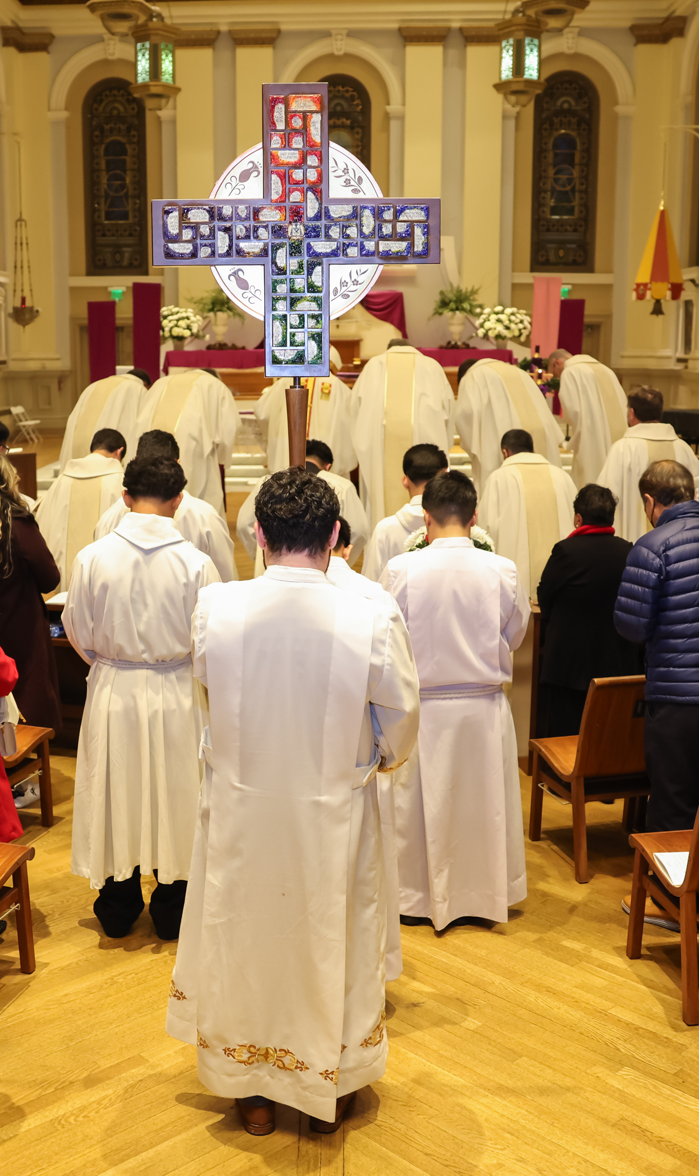

Lent 2026: Welcoming & Participation
Parts of the Mass
Gathering, Penitential Act, Gloria (when used), Collect, Liturgical Year
Pastoral Focus
The role of the assembly - active and conscious participation through preparation, responding and singing (music is not a performance)
Being formed as one body, welcoming all and asking for mercy.
By walking through the seasons of the liturgical year to helps us understand and deepen the different “seasons” of our lives
Lay Minister Training Focus
Sacristan, Mass Coordinator, Art and Environment, Altar Server Coordinators, Usher, Greeter, Music Directors
Date: Rollout begins on the First Sunday of Lent 2026
Unified practices in all Masses by July 1st, 2026
Notes:
--- The first phase during Lent 2026 sets the tone for the entire renewal process. Its primary focus is on deepening Eucharistic devotion and fostering a spirit of penitence. Parishes will receive catechetical materials emphasizing the theology of the Eucharist and the importance of active participation in Mass. Initiatives include promoting Eucharistic Adoration, enhancing the quality of homilies, and encouraging personal and communal prayer practices. Clergy workshops will address preaching during penitential seasons, while lay ministers will be trained to support liturgical preparation and execution. Communication strategies will highlight the spiritual significance of Lent, using diocesan channels to share reflections, video messages, and parish success stories. This phase also introduces the concept of renewal as a journey, inviting parishioners to commit to ongoing formation. By grounding the process in prayer and sacramental life, Lent 2026 establishes a strong foundation for subsequent phases, ensuring that renewal is not merely procedural but deeply spiritual. Image source: Microsoft 365 content library

Slide 10
Key Dates for phase 1 – full implementation July 1st, 2026
February 5 CLERGY KICKOFF
February - March PARISH LITURGICAL LEADER WORKSHOPS
March - April 10 PARISH MINISTRY TRAINING & PREPARATION
April 12 – June 30 PARISHIONER CATECHESIS & PRACTICE
July 1st UNIFIED PRACTICES IN ALL MASSES

Slide 11
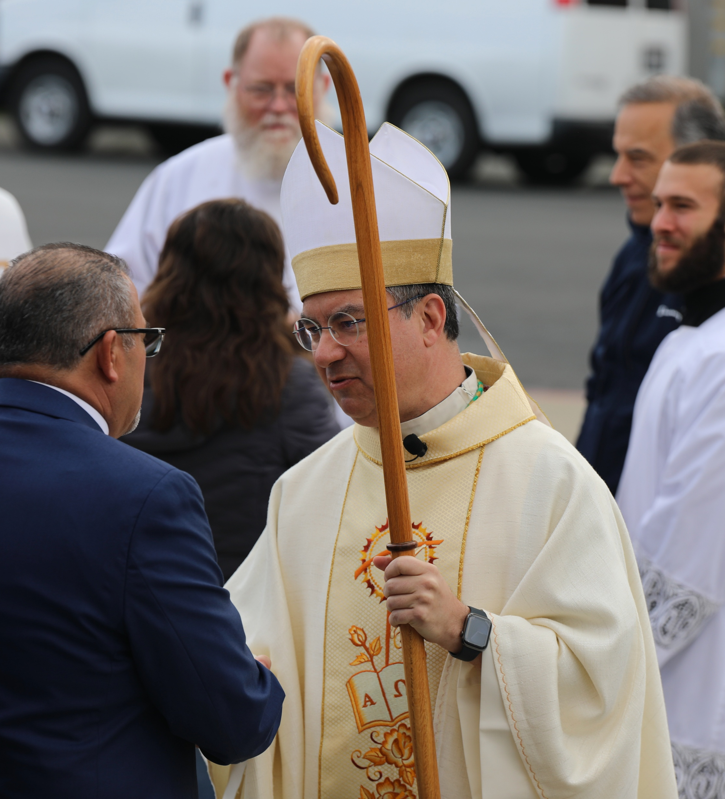
Parishioner Catechesis Phase One – starts April 12th
Trilingual Content (Bulletin Articles, Social Media, Images)
You can adapt the timing for your community needs
Phase One - Weekly Themes
Week 1 (April 12-13): Introduction & Invitation
Week 2 (April 19-20): Ministry of the Assembly
Week 3 (April 26-27): Entrance & Gathering
Week 4 (May 3-4): Music as Ministry
Week 5 (May 10-11): Penitential Act & Gloria
Week 6 (May 17-18): Liturgical Year & Collect
Notes:
--- Effective communication is essential for the success of the liturgical renewal. The diocesan communications strategy includes multi-channel outreach through bulletins, social media, email newsletters, and video messages from diocesan leadership. Parish toolkits will provide templates for announcements, catechetical materials, and visual aids to ensure consistent messaging across communities. These resources will be available in English, with plans for future multilingual adaptations. The strategy emphasizes storytelling, sharing parish success stories to inspire engagement and foster a sense of shared mission. Regular updates will keep stakeholders informed about upcoming phases, training opportunities, and available resources. By prioritizing clear, consistent, and inspiring communication, the diocese aims to build momentum and sustain enthusiasm throughout the two-year arc. Image source: Microsoft 365 content library

Slide 12
ACTIVITY
MUSIC MINISTRY - Overview
Participation in the Sacred liturgy by all the people gathered is to be considered, above all else (STTL 13)
The quality of our participation as members of the assembly comes less from our vocal ability than from the desire of our hearts to sing together for the love of God
When we sing or accompany liturgy, we are instruments in God’s hands
In addition to helping the assembly express their faith, music ministers facilitate the unique capacity of music to nourish and strengthen the interior participation of the faithful
Notes:
“This is not a standalone initiative. It’s one strand of how we live the pastoral plan—specifically the priority of Worship.”

Slide 13
ACTIVITY
MUSIC MINISTRY - Overview
Hospitality is an integral part of music ministry.
Music ministry can be welcoming and attentive when
Ministers prepare for the liturgy by becoming familiar with the liturgical text as well as with the music with which it is proclaimed
Ministers make an effort to enunciate clearly so that the liturgical text can be understood while it is sung
The gestures and postures of the ministers invite the assembly to be united in song
Notes:
“This is not a standalone initiative. It’s one strand of how we live the pastoral plan—specifically the priority of Worship.”

Slide 14
ACTIVITY
LITURGICAL MUSIC - Overview
“Sacred music is to be considered the more holy in proportion as it is more closely connected with the liturgical action, whether it adds delight to prayer, fosters unity of minds, or confers greater solemnity upon the sacred rites.” (Sacrosactum Concilium, 112)
Music unites the assembly: it is not “in or for the liturgy”, it is liturgy
Music ministry varies in every parish, adapting to the cultural and physical needs of the community it serves
Liturgical music is not a series of hymns “plugged” into a part of the Mass – Liturgical music is divine worship and is integral to the rituals
Notes:
“This is not a standalone initiative. It’s one strand of how we live the pastoral plan—specifically the priority of Worship.”

Slide 15
ACTIVITY
Three judgements of good liturgical music
LITURGICAL JUDGEMENT
Does it fit within the order of the liturgy?
If it is a musical setting of the Order of the Mass, then all of the words of the text need to be included.
Are the rubrics that apply to music ministry being followed?
Notes:
“This is not a standalone initiative. It’s one strand of how we live the pastoral plan—specifically the priority of Worship.”

Slide 16
ACTIVITY
Three judgements of good liturgical music
PASTORAL JUDGEMENT
Are you taking into consideration the actual community that is gathered at that particular place at that particular time? Liturgical ministers must know the community they serve.
Are you considering the diversity of the assembly, in cultural background, in language, age and other factors?
“Knowing the community we serve and minister to – not just in general, but at each celebration- is essential.” (STTL, 133)
Notes:
“This is not a standalone initiative. It’s one strand of how we live the pastoral plan—specifically the priority of Worship.”

Slide 17
ACTIVITY
Three judgements of good liturgical music
ARTISTIC OR MUSICAL JUDGEMENT
Does each composition have the necessary aesthetic qualities that can bear the weight of the mysteries celebrated in the liturgy? (STTL 134)
Notes:
“This is not a standalone initiative. It’s one strand of how we live the pastoral plan—specifically the priority of Worship.”

Slide 18
ACTIVITY
Recommendations for music ministers
Wrap up practice and warm up at least 5 minutes before mass
Allow for quiet and prayerful reflection
If teaching a new hymn or psalm response to the congregation, do so immediately before Mass begins
* GIRM 117
Notes:
“This is not a standalone initiative. It’s one strand of how we live the pastoral plan—specifically the priority of Worship.”

Slide 19
resources
GENERAL INSTRUCTION OF THE ROMAN MISSAL. (GIRM)
Published as part of the 3rd Edition of the Roman Missal (2010)
USCCB website with full text of GIRM:
English: https://www.usccb.org/prayer-and-worship/the-mass/general-instruction-of-the-roman-missal
Spanish: Institucion General del Misal Romano https://www.usccb.org/es/prayer-and-worship/the-mass/general-instruction-of-the-roman-missal
SING TO THE LORD: Music in Divine Worship (STTL)
Published by the USCCB, June 2008

Slide 20
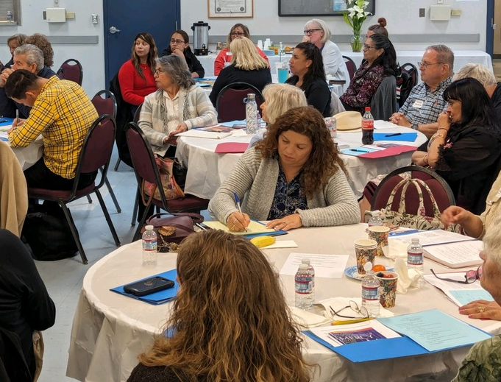
ACTIVITY
Reflection
What approach to your ministry would help you to center yourself spiritually and gain insight into the season or day for which you are preparing?
Notes:
“This is not a standalone initiative. It’s one strand of how we live the pastoral plan—specifically the priority of Worship.”

Slide 21
Contact information
DIOCESAN LITURGICAL COMMISSION
OFFICE OF WORSHIP
Father Jeff Fernandez - Chair
Father Chris Bennett
Father Gerardo Menchaca
Father Hao Dinh
Father Ritche Bueza
Deacon Richard Noack
Sister Catherine Dang
Blessie LaScola
Amy Stacke
Veronica Duluk
DIRECTOR: Father Jeff Fernandez
jeff.Fernandez@dsj.org
(408)983-0136
ADMIN. ASSISTANT: Kristine Lalaquit
Kristine.lalaquit@dsj.org
(408)983-0139
PROJECT COORDINATOR: Mary Jewell
mary.jewell@dsj.org
408-983-0127

