Slide 1
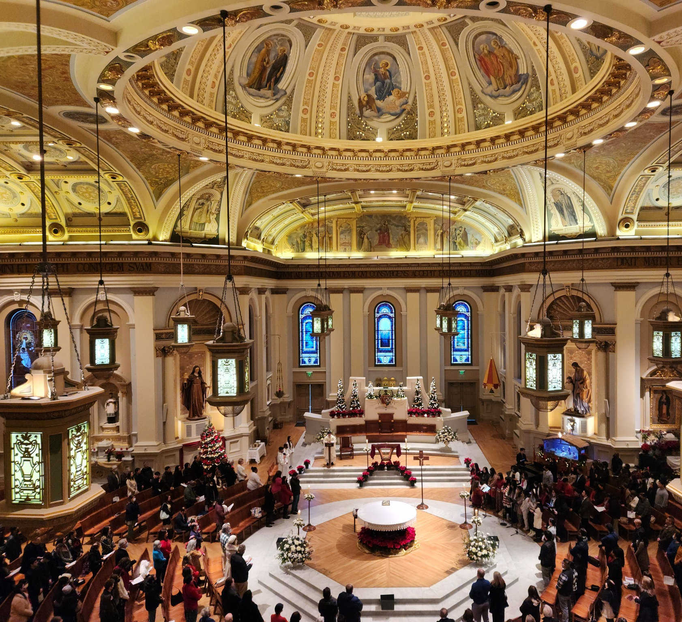
Liturgical Renewal SACRISTAN WORKSHOP
Renewed at the Table of the Lord
February, 2026
Notes:
---
Image source: Microsoft 365 content library

Slide 2
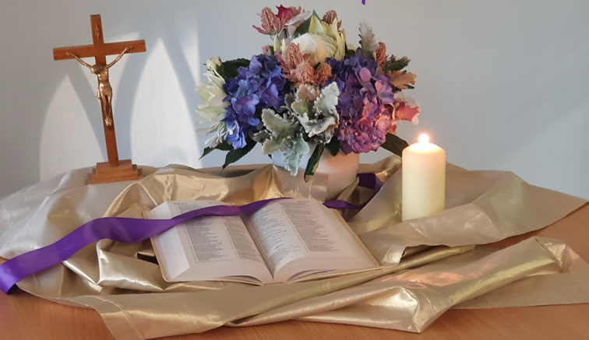
ACTIVITY
Opening Prayer
Scripture: Matthew 20: 25-28
But Jesus summoned them and said, “You know that the rulers of the Gentiles lord it over them, and the great ones make their authority over them felt.
But it shall not be so among you. Rather, whoever wishes to be great among you shall be your servant; whoever wishes to be first among you shall be your slave.
Just so, the Son of Man did not come to be served but to serve and to give his life as a ransom* for many.”
Notes:
“This is not a standalone initiative. It’s one strand of how we live the pastoral plan—specifically the priority of Worship.”

Slide 3
ACTIVITY
Activity
Share one word or phrase that describes how you feel when you walk into church for Mass?
Notes:
“This is not a standalone initiative. It’s one strand of how we live the pastoral plan—specifically the priority of Worship.”

Slide 4
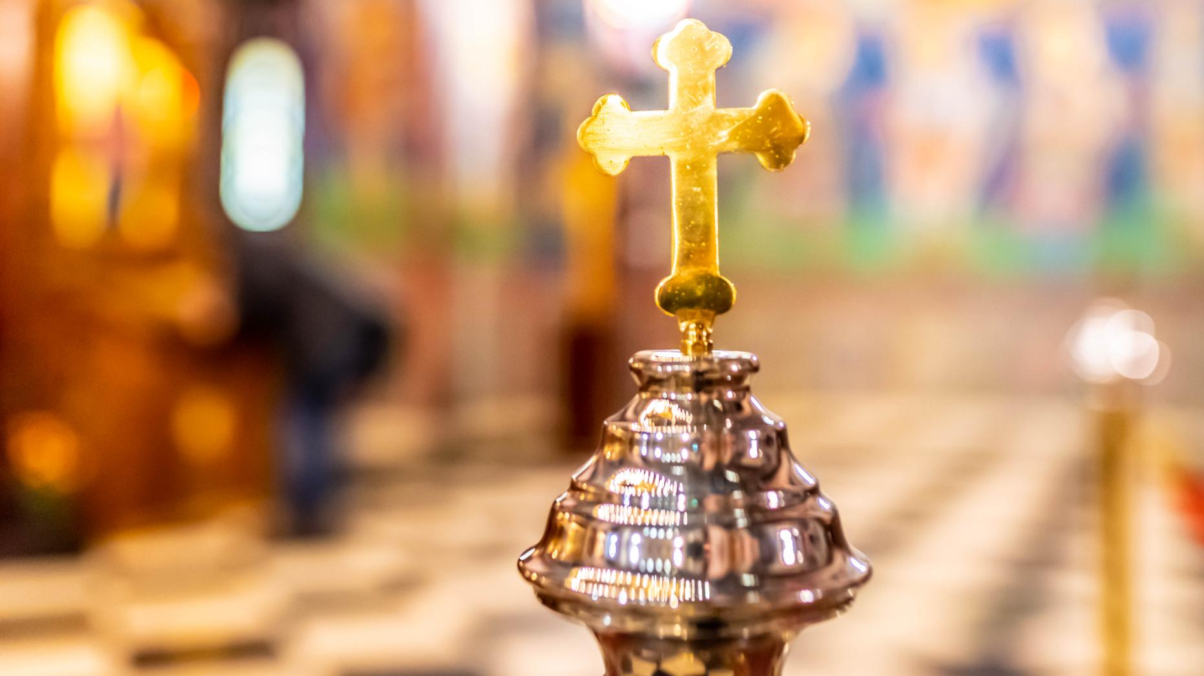
Liturgical renewal is a diocesan effort to deepen spiritual renewal by helping our people more fully, consciously, and actively participate in the Mass—the source and summit of our life together.
Why Liturgical Renewal — in one sentence
Notes:
---
The diocesan initiative for liturgical renewal aims to deepen the spiritual life of parishes by fostering authentic participation in the sacred liturgy over a two-year period. This plan is rooted in the Church’s call for ongoing renewal, emphasizing reverence, beauty, and active engagement with the Eucharist as the source and summit of Christian life. The objectives include strengthening catechesis on liturgical theology, enhancing the quality of celebrations, and equipping clergy and lay ministers with resources to lead renewal efforts effectively. By focusing on seasonal phases aligned with the liturgical calendar, the plan ensures that renewal is not a one-time event but a sustained journey of formation and transformation. Key goals include improving homiletic quality, promoting sacred music that reflects the Church’s tradition, and fostering a culture of prayerful preparation among ministers and congregations. This vision also addresses pastoral challenges such as balancing tradition with accessibility, ensuring inclusivity while maintaining doctrinal integrity, and responding to cultural diversity within the diocese. Ultimately, the renewal seeks to inspire a deeper encounter with Christ through the liturgy, strengthening parish identity and unity across communities.
Image source: Microsoft 365 content library

Slide 5
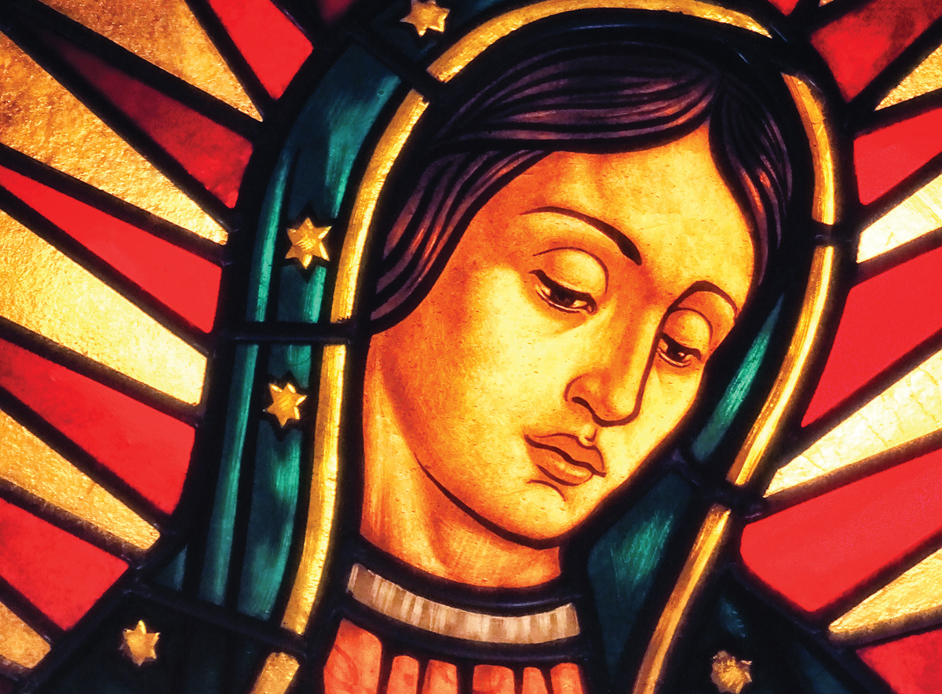
Spiritual and Pastoral Frames
EUCHARIST – The Eucharist as the “source and summit” of Christian life
ASSEMBLY – Vatican II called all members of the assembly to actively participate in the liturgy
UNITY – Our Lady of Guadalupe gathers us as ONE family leads us to Christ
Notes:
The diocesan initiative for liturgical renewal aims to deepen the spiritual life of parishes by fostering authentic participation in the sacred liturgy over a two-year period. This plan is rooted in the Church’s call for ongoing renewal, emphasizing reverence, beauty, and active engagement with the Eucharist as the source and summit of Christian life. The objectives include strengthening catechesis on liturgical theology, enhancing the quality of celebrations, and equipping clergy and lay ministers with resources to lead renewal efforts effectively. By focusing on seasonal phases aligned with the liturgical calendar, the plan ensures that renewal is not a one-time event but a sustained journey of formation and transformation. Key goals include improving homiletic quality, promoting sacred music that reflects the Church’s tradition, and fostering a culture of prayerful preparation among ministers and congregations. This vision also addresses pastoral challenges such as balancing tradition with accessibility, ensuring inclusivity while maintaining doctrinal integrity, and responding to cultural diversity within the diocese. Ultimately, the renewal seeks to inspire a deeper encounter with Christ through the liturgy, strengthening parish identity and unity across communities.
Image source: Microsoft 365 content library

Slide 6
TIMELINE FOR LITURGICAL RENEWAL
Lent 2026
Introductory Rite
Fall 2026
Liturgy of the Word
Lent/Easter 2027
Liturgy of Eucharist
Fall 2027
Communion and Concluding Rites
Notes:
The two-year arc is structured around four major phases corresponding to key liturgical seasons: Lent 2026, Fall 2026, Lent/Easter 2027, and Fall 2027. Each phase builds upon the previous, creating a rhythm of catechesis, formation, and implementation. Lent 2026 initiates the renewal with a focus on penitential practices and Eucharistic devotion, encouraging parishes to adopt resources for deepening prayer and sacramental life. Fall 2026 emphasizes community engagement and the enrichment of Sunday worship, introducing training modules for music ministers and lectors. Lent/Easter 2027 centers on the Paschal Mystery, integrating catechetical series on sacramental theology and fostering vibrant celebrations of the Triduum. Finally, Fall 2027 consolidates the renewal by evaluating progress, addressing challenges, and embedding best practices into parish life. A timeline graphic will illustrate these phases, highlighting key milestones such as clergy workshops, parish toolkit distribution, and diocesan-wide liturgical celebrations. This phased approach ensures gradual implementation, allowing time for feedback and adaptation while maintaining momentum. By aligning with the liturgical calendar, the plan leverages natural opportunities for spiritual renewal and catechesis, making the process both organic and impactful.

Slide 7
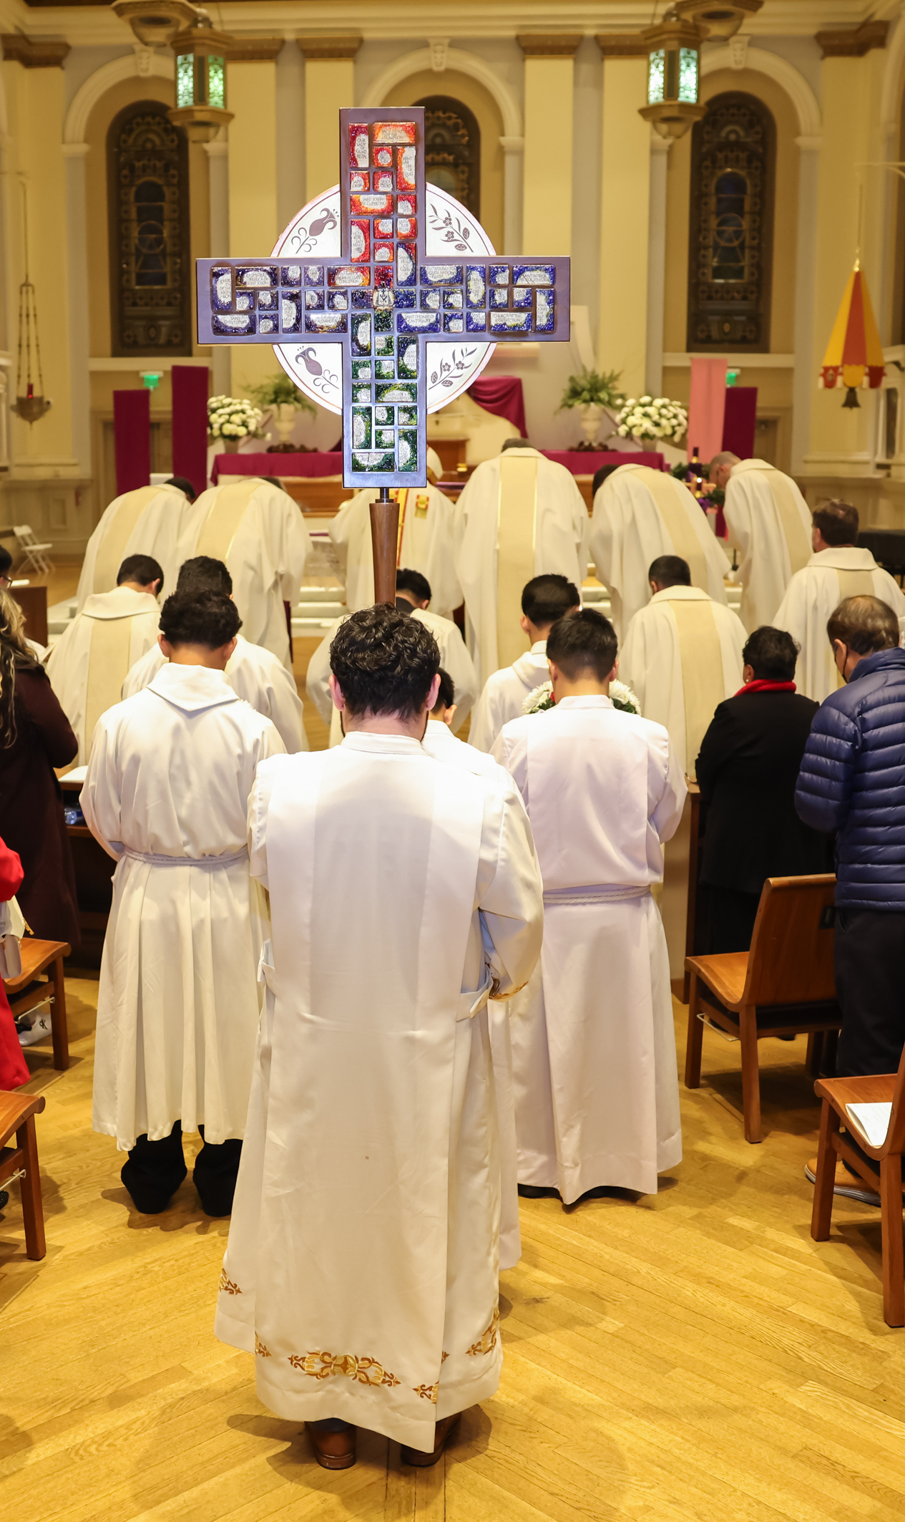

Lent 2026: Welcoming & Participation
Parts of the Mass
  Gathering, Penitential Act, Gloria (when used), Collect, Liturgical Year
Pastoral Focus
  The role of the assembly - active and conscious participation through preparation, responding and singing (music is not a performance)
  Being formed as one body, welcoming all and asking for mercy.
  By walking through the seasons of the liturgical year to helps us understand and deepen the different “seasons” of our lives
  Lay Minister Training Focus
Sacristan, Mass Coordinator, Art and Environment, Altar Server Coordinators, Usher, Greeter, Music Directors
Date: Rollout begins on the First Sunday of Lent 2026
Unified practices in all Masses by July 1, 2026
Notes:
---
The first phase during Lent 2026 sets the tone for the entire renewal process. Its primary focus is on deepening Eucharistic devotion and fostering a spirit of penitence. Parishes will receive catechetical materials emphasizing the theology of the Eucharist and the importance of active participation in Mass. Initiatives include promoting Eucharistic Adoration, enhancing the quality of homilies, and encouraging personal and communal prayer practices. Clergy workshops will address preaching during penitential seasons, while lay ministers will be trained to support liturgical preparation and execution. Communication strategies will highlight the spiritual significance of Lent, using diocesan channels to share reflections, video messages, and parish success stories. This phase also introduces the concept of renewal as a journey, inviting parishioners to commit to ongoing formation. By grounding the process in prayer and sacramental life, Lent 2026 establishes a strong foundation for subsequent phases, ensuring that renewal is not merely procedural but deeply spiritual.
Image source: Microsoft 365 content library

Slide 8
Key Dates for phase 1 – full implementation July 1st, 2026
February 24 - March 22 PARISH LITURGICAL LEADER WORKSHOPS
March 22 - April 10 VOLUNTEER CATECHESIS AND PREPARATION FOR PARISHIONER LAUNCH
April 12 – June 20 PARISHIONER CATECHESIS & PRACTICE

Slide 9
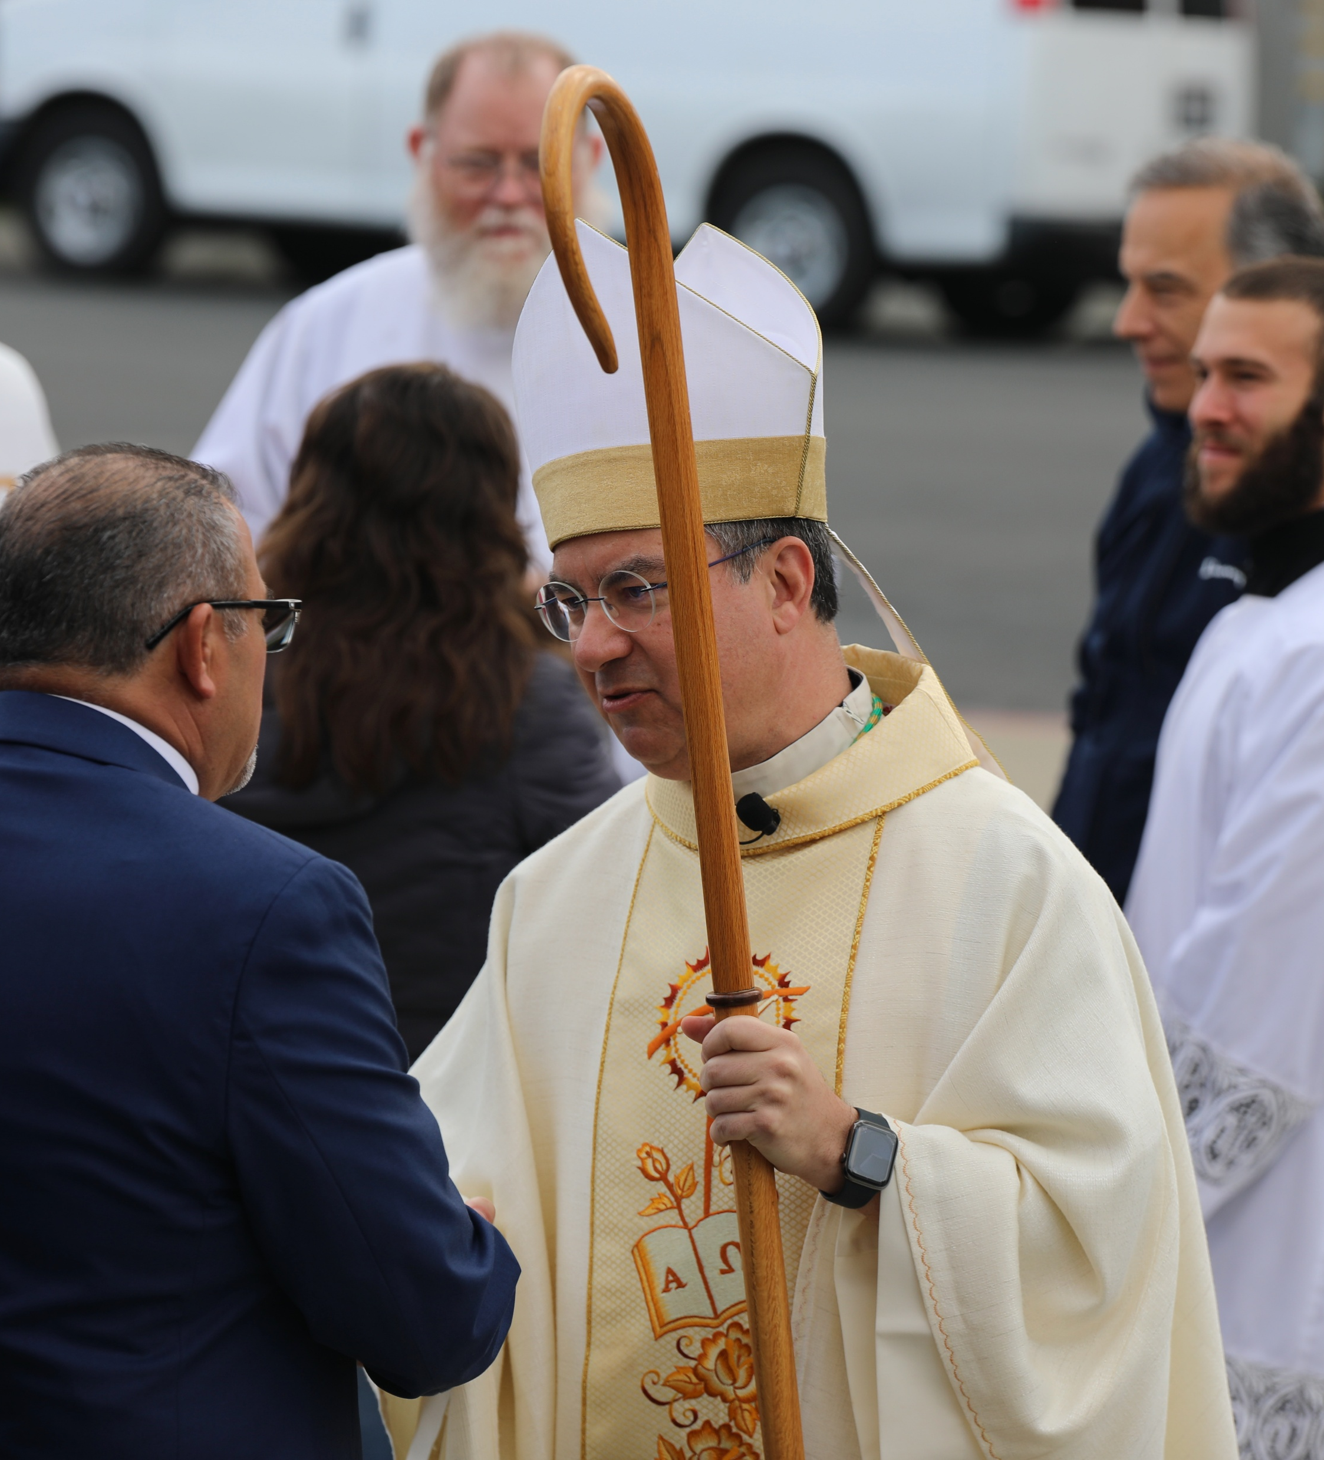
Parishioner Catechesis Phase One – starts April 12th
  Trilingual Content (Bulletin Articles, Social Media, Images)
      You can adapt the timing for your community needs
  Phase One - Weekly Themes
      Week 1 (April 12-13): Introduction & Invitation
      Week 2 (April 19-20): Ministry of the Assembly
      Week 3 (April 26-27): Entrance & Gathering
      Week 4 (May 3-4): Music as Ministry
      Week 5 (May 10-11): Penitential Act & Gloria
      Week 6 (May 17-18): Liturgical Year & Collect
Notes:
---
Effective communication is essential for the success of the liturgical renewal. The diocesan communications strategy includes multi-channel outreach through bulletins, social media, email newsletters, and video messages from diocesan leadership. Parish toolkits will provide templates for announcements, catechetical materials, and visual aids to ensure consistent messaging across communities. These resources will be available in English, with plans for future multilingual adaptations. The strategy emphasizes storytelling, sharing parish success stories to inspire engagement and foster a sense of shared mission. Regular updates will keep stakeholders informed about upcoming phases, training opportunities, and available resources. By prioritizing clear, consistent, and inspiring communication, the diocese aims to build momentum and sustain enthusiasm throughout the two-year arc.
Image source: Microsoft 365 content library

Slide 10
ACTIVITY
Sacristan ministry - Overview
The ministry of the sacristan and mass coordinator is to cares for sacred spaces, prepare for Mass and ensure everything is clean and put back in its proper place after mass.
The sacristan prepares the things that are necessary for the celebration of liturgy:
  Vestments for the clergy and lay ministers
  books of the liturgy: the Roman Missal, Book of Gospels and Lectionary
  vessels, bread and wine, Incense, altar linens, candles, etc.
Sacristans assist the presider in preparing an orderly entrance procession
Sacristans keep the sacristy tidy and orderly
Notes:
“This is not a standalone initiative. It’s one strand of how we live the pastoral plan—specifically the priority of Worship.”

Slide 11
Summary of the liturgical seasons
Season | Focus | Liturgical Color
Advent | Preparation for Christ’s coming | Purple/Rose
Christmas | Nativity of Jesus | White/Gold
Ordinary Time (I) | Christ’s ministry | Green
Lent | Repentance, preparation for Easter | Purple
Easter | Resurrection, new life | White/Gold
Ordinary Time (II) | Growth in faith | Green
Liturgical Seasons - Summary
Notes:
“This is not a standalone initiative. It’s one strand of how we live the pastoral plan—specifically the priority of Worship.”

Slide 12
ACTIVITY
Common Guidelines & Rules
  Altar-The entire top surface of the Altar should be covered with a white cloth, on which a Corporal will be placed during Mass*.
    Parishes may use altar cloths to cover the altar that corresponds to the liturgical season, as long as there is a white cloth on top covering the entire altar surface.
    Altar should be clear
  Environment should not impede the liturgy or any ministers e.g. Altar Servers, Lectors, EMHC, etc.
* GIRM 117
Notes:
“This is not a standalone initiative. It’s one strand of how we live the pastoral plan—specifically the priority of Worship.”

Slide 13
ACTIVITY
Common Guidelines & Rules
  One Crucifix
    Within the Sanctuary, there must be only one crucifix*, with figure of Christ crucified.
    If there is not a permanent crucifix in the Sanctuary with the figure of the crucified Christ, then the processional cross, provided it has the figure of Christ Crucified, may be placed in a stand near the altar to serve this purpose.
    If there is a permanent crucifix in the Sanctuary with the figure of the crucified Christ, then at the conclusion of the entrance procession the processional cross must be placed in a respectful location out of the view of the Assembly, such as in the Sacristy or behind a wall or banner.
    Also, if there is a permanent crucifix in the Sanctuary, another crucifix on the altar is not permitted.
* GIRM 117
Notes:
“This is not a standalone initiative. It’s one strand of how we live the pastoral plan—specifically the priority of Worship.”

Slide 14
ACTIVITY
Common Guidelines & Rules
  One statue of Our Lady, etc.
  Cultural pieces
  Cultural traditions, Devotionals, etc.
  Liturgical items
    Vestments and dress should reflect the celebration
    Create environment around liturgical pieces, with wax candles, greenery, etc.
    Living or freshly cut plants and flowers
    All flowers and green plants used in the Sanctuary must be live (or in the case of flowers those that have been live and cut), not silk, plastic, or artificial
Notes:
“This is not a standalone initiative. It’s one strand of how we live the pastoral plan—specifically the priority of Worship.”

Slide 15
ACTIVITY
Common Guidelines & Rules
  Use of candles within the environment, adding to the passage of time like the liturgical season, the scripture, etc.
    Candles are indicative of the passage of time
    All candles used in the Sanctuary, including at the Tabernacle and Altar must be made out of wax and have a live flame. This also applies to the Paschal candle.
  Dispose of old Books and oils properly
    How...
Notes:
“This is not a standalone initiative. It’s one strand of how we live the pastoral plan—specifically the priority of Worship.”

Slide 16
ACTIVITY
Common Guidelines & Rules
Striving for Ideal – where heaven meets earth
  Visual movement is important in the liturgy.
  The environment speaks to the celebration color, tone, prayer, and music.
Notes:
“This is not a standalone initiative. It’s one strand of how we live the pastoral plan—specifically the priority of Worship.”

Slide 17
Reference materials
GENERAL INSTRUCTION OF THE ROMAN MISSAL
  Published as part of the 3rd Edition of the Roman Missal (2010)
  Booklet published by LTP (Liturgy Training Publications)
  USCCB website URL:
    English: https://www.usccb.org/prayer-and-worship/the-mass/general-instruction-of-the-roman-missal
    Spanish: Institucion General del Misal Romano https://www.usccb.org/es/prayer-and-worship/the-mass/general-instruction-of-the-roman-missal
GUIDE FOR SACRISTANS, Third Edition, by Corinna Laughlin and Paul Turner
  Booklet published by LTP (Liturgy Training Publications)
  Part of the The Liturgical Ministry Series

Slide 18
Contact information
DIOCESAN LITURGICAL COMMISSION
OFFICE OF WORSHIP
Father Jeff Fernandez - Chair
Father Chris Bennett
Father Gerardo Menchaca
Father Hao Dinh
Father Ritche Bueza
Deacon Richard Noack
Sister Catherine Dang
Blessie LaScola
Amy Stacke
Veronica Duluk
DIRECTOR: Father Jeff Fernandez
jeff.Fernandez@dsj.org
(408)983-0136
ADMIN. ASSISTANT: Kristine Lalaquit
Kristine.lalaquit@dsj.org
(408)983-0139
PROJECT COORDINATOR: Mary Jewell
    mary.jewell@dsj.org
    408-983-0127

Slide 19
ADDITIONAL INFORMATION

Slide 20
LITURGICAL BOOKS FOR THE EUCHARIST
Roman Missal (including General Instruction & Calendar) 2008 (1974; 1985) 2011
Excerpts from the Roman Missal (“Book of the Chair”) 2018
Lectionary for Mass 1981 (1970) 1998/2002
Lectionary for Mass Supplement 2017
Collection of Masses of the Blessed Virgin Mary 1987 (1992) 2012
Sunday Celebrations in the Absence of a Priest (1988; 2007) 2012
Eucharistic Prayers for Masses with Children 2002 (1985) 2011
Lectionary for Masses with Children 1993

Slide 21
OTHER SACRAMENTAL AND RITUAL BOOKS
Order of Confirmation 2003 (1978; 2012) 2015
Order of Baptism of Children 2003 (1970) 2020
Order of Christian Initiation of Adults 1972 (1974; 1988) 2024
Holy Communion and Worship of the Eucharist Outside Mass 1974 (1976) 2024
Order of Celebrating Matrimony 2008 (1970) 2016
Order of Penance 1974 (1975; 2010) 2023
Order of Anointing of the Sick and Their Pastoral Care 1972 (1974) (1983) 2026
Book of Blessings 1994; 1989
Order of Christian Funerals 1969 (1971) 1989

Slide 22
The Church Building - Glossary
The Nave- The people who come for worship take their places in the nave. It is the place where they assemble.
The Sanctuary- an elevated areas separated from the nave by its elevation or its ornamentation ª. It holds the primary furnishings needed for Mass: the altar, the ambo and the chair.
The Altar - resembles a table and should be the center of attention ^{b}
The Ambo – The Word of God is proclaimed from the ambo, which resembles a lectern or pulpit ^{c}. It should be large enough to accommodate the Book of Gospels. The responsorial psalm and the prayer of the faithful are sung or read from the ambo.
GIRM: a-295; b-296; c-309

Slide 23
The Church Building - Glossary
The Chair – the priest who celebrates the Mass has his own place to sit ^{d}. His chair has the same function as the head of the dining room table
Other Seating – chair for the deacon next to the priest; chairs for altar servers or other ministers should be in the sanctuary but be less prominent
Cross and Candles – the physical relationship between the altar and the cross indicates the meaning of the actions on the altar ^{e}. The candles are a sign of light, reverence and festivity ^{f}.
Vestments and Vessels – Clergy wear colors that announce the season, feast or occasion being celebrated. Vestments and vessels should be clean, beautiful and functional ^{g}.
GIRM: d-310; e-117,122, 308; f-307; g-327-347

Slide 24
The Church Building - Glossary
Credence Table – holds the items needed for Mass and sits near a sanctuary wall.
The Tabernacle – the consecrated Eucharistic bread is kept under lock and key in the tabernacle ^{h}.
The Font – it is the place for baptism and should be suitable for both immersion and pouring
The Ambry – the area where the sacred oils are reserved
The Narthex – the gathering area inside the main exterior doors of the church
The Sacristy – area for the vesting of ministers and for the storage and cleaning of vessels
GIRM: h-314-315;

