Slide 1
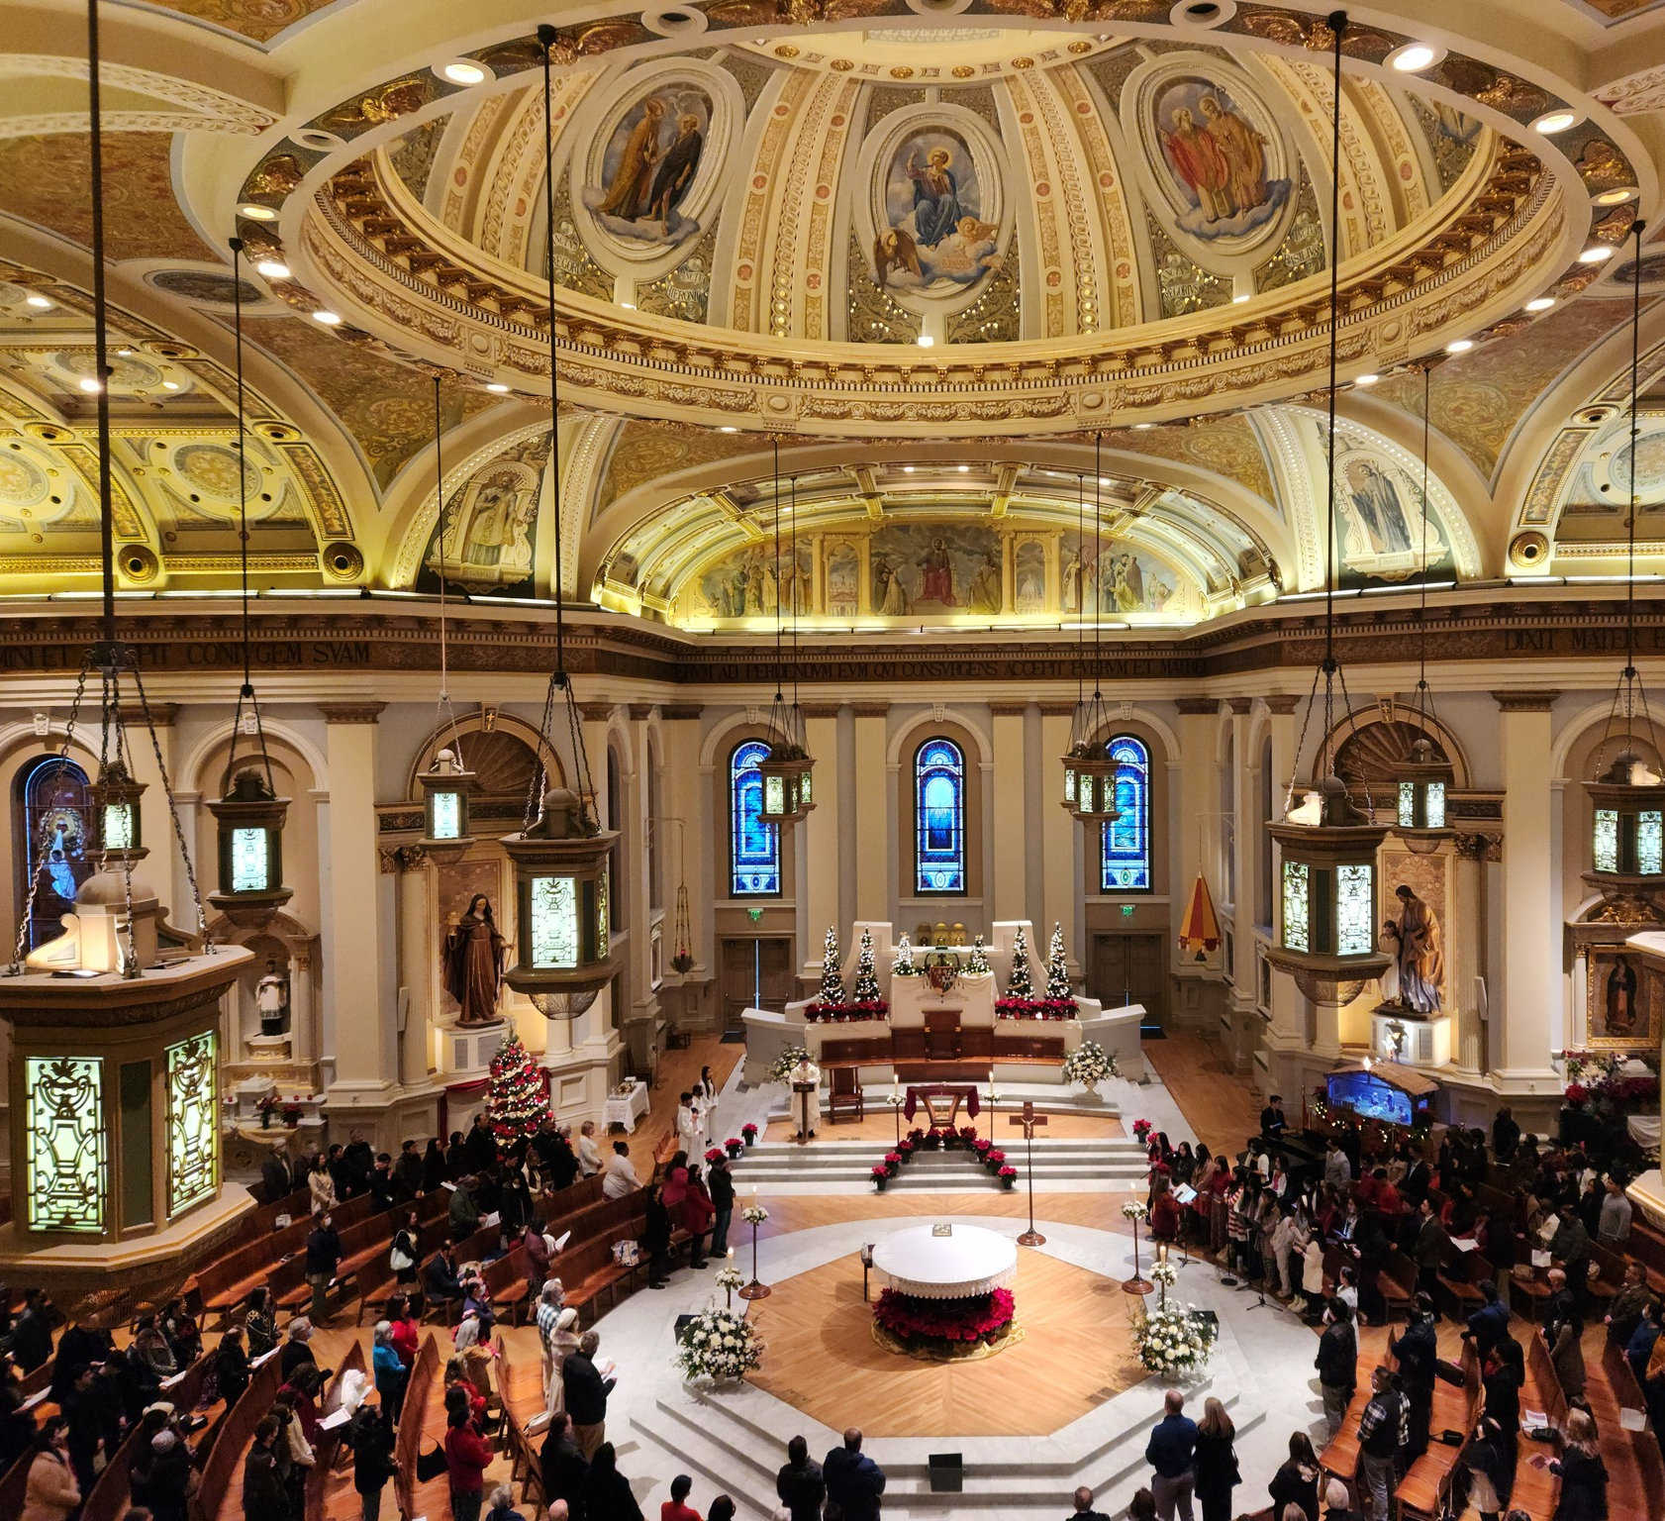
Liturgical Renewal hospitality MINISTRY WORKSHOP
Renewed at the Table of the Lord
March 2026
Notes:
---
Image source: Microsoft 365 content library

Slide 2
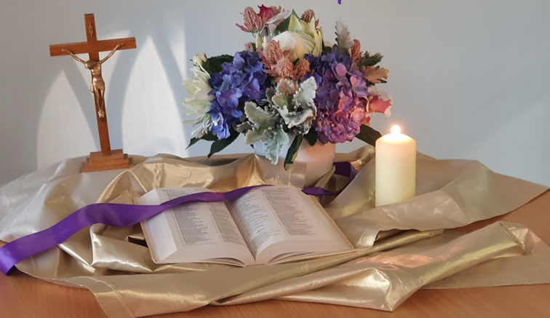
ACTIVITY
Opening Prayer
Scripture: Matthew 20: 25-28
But Jesus summoned them and said, “You know that the rulers of the Gentiles lord it over them, and the great ones make their authority over them felt.
But it shall not be so among you. Rather, whoever wishes to be great among you shall be your servant; whoever wishes to be first among you shall be your slave.
Just so, the Son of Man did not come to be served but to serve and to give his life as a ransom* for many.”
Notes:
“This is not a standalone initiative. It’s one strand of how we live the pastoral plan—specifically the priority of Worship.”

Slide 3
ACTIVITY
Activity
Share one word or phrase that describes how you feel when you walk into church for Mass?
Notes:
“This is not a standalone initiative. It’s one strand of how we live the pastoral plan—specifically the priority of Worship.”

Slide 4
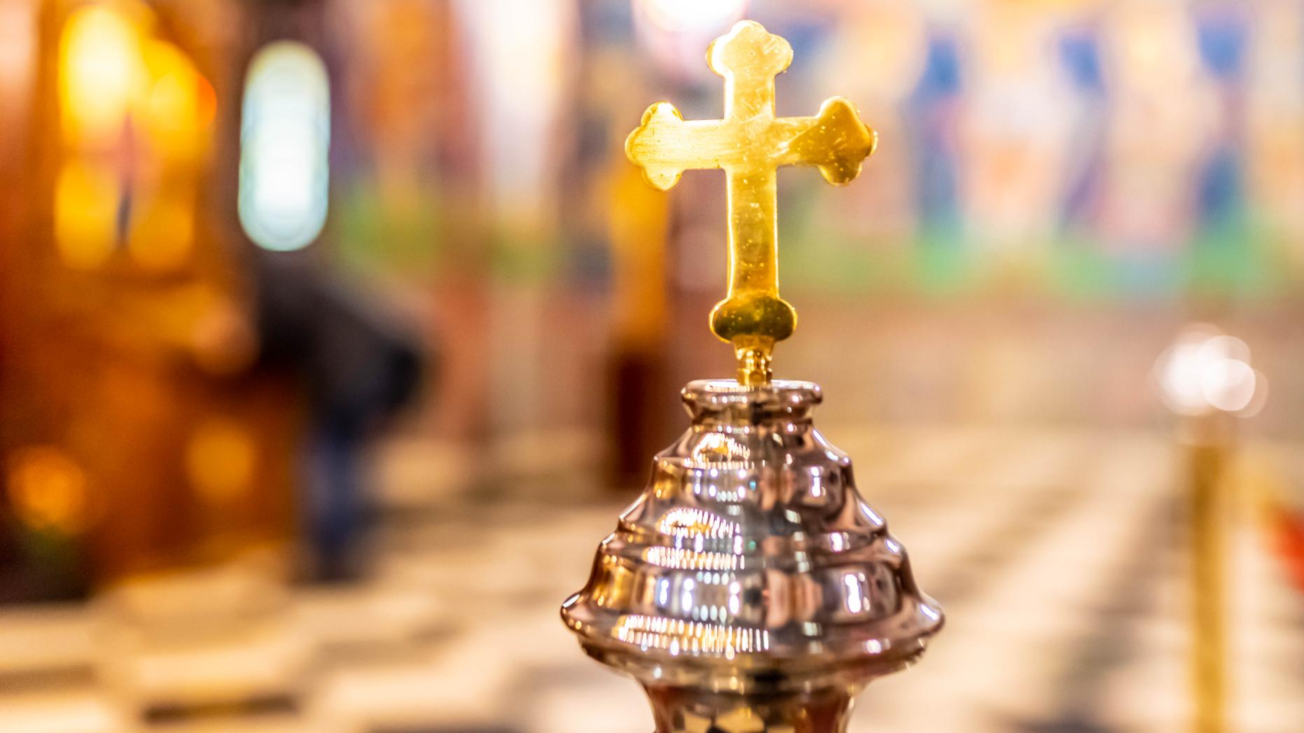
Liturgical renewal is a diocesan effort to deepen spiritual renewal by helping our people more fully, consciously, and actively participate in the Mass—the source and summit of our life together.
Why Liturgical Renewal — in one sentence
Notes:
---
The diocesan initiative for liturgical renewal aims to deepen the spiritual life of parishes by fostering authentic participation in the sacred liturgy over a two-year period. This plan is rooted in the Church’s call for ongoing renewal, emphasizing reverence, beauty, and active engagement with the Eucharist as the source and summit of Christian life. The objectives include strengthening catechesis on liturgical theology, enhancing the quality of celebrations, and equipping clergy and lay ministers with resources to lead renewal efforts effectively. By focusing on seasonal phases aligned with the liturgical calendar, the plan ensures that renewal is not a one-time event but a sustained journey of formation and transformation. Key goals include improving homiletic quality, promoting sacred music that reflects the Church’s tradition, and fostering a culture of prayerful preparation among ministers and congregations. This vision also addresses pastoral challenges such as balancing tradition with accessibility, ensuring inclusivity while maintaining doctrinal integrity, and responding to cultural diversity within the diocese. Ultimately, the renewal seeks to inspire a deeper encounter with Christ through the liturgy, strengthening parish identity and unity across communities.
Image source: Microsoft 365 content library

Slide 5
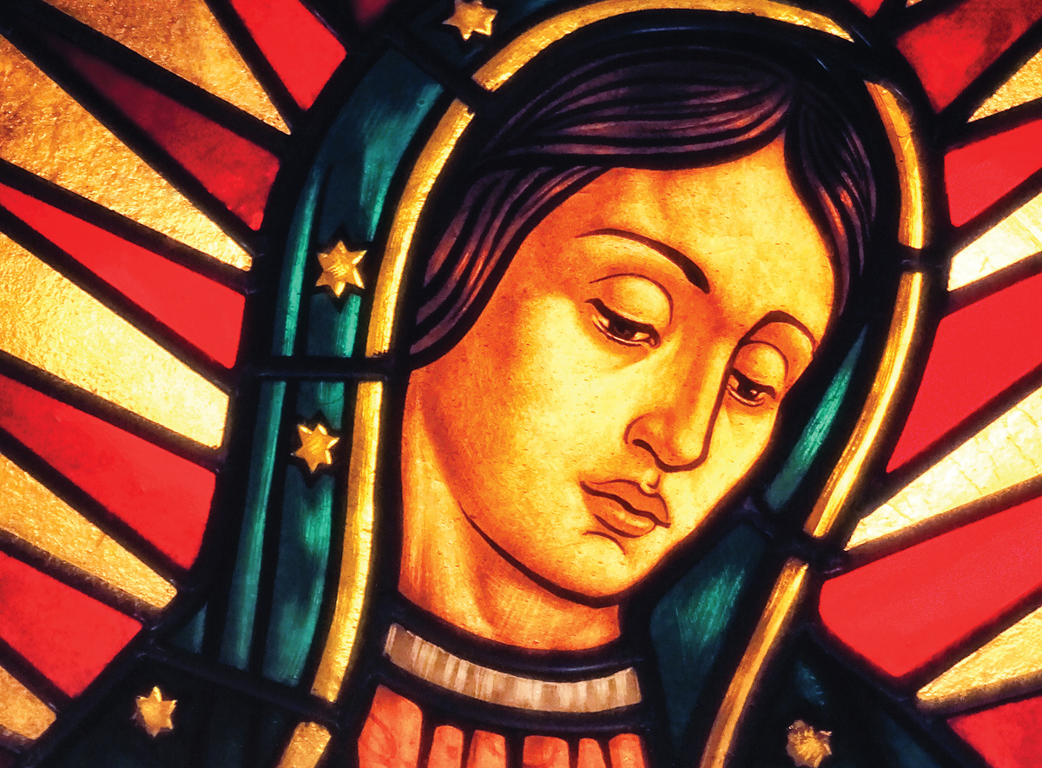
Spiritual and Pastoral Frames
EUCHARIST – The Eucharist as the “source and summit” of Christian life
ASSEMBLY – Vatican II called all members of the assembly to actively participate in the liturgy
UNITY – Our Lady of Guadalupe gathers us as ONE family leads us to Christ
Notes:
The diocesan initiative for liturgical renewal aims to deepen the spiritual life of parishes by fostering authentic participation in the sacred liturgy over a two-year period. This plan is rooted in the Church’s call for ongoing renewal, emphasizing reverence, beauty, and active engagement with the Eucharist as the source and summit of Christian life. The objectives include strengthening catechesis on liturgical theology, enhancing the quality of celebrations, and equipping clergy and lay ministers with resources to lead renewal efforts effectively. By focusing on seasonal phases aligned with the liturgical calendar, the plan ensures that renewal is not a one-time event but a sustained journey of formation and transformation. Key goals include improving homiletic quality, promoting sacred music that reflects the Church’s tradition, and fostering a culture of prayerful preparation among ministers and congregations. This vision also addresses pastoral challenges such as balancing tradition with accessibility, ensuring inclusivity while maintaining doctrinal integrity, and responding to cultural diversity within the diocese. Ultimately, the renewal seeks to inspire a deeper encounter with Christ through the liturgy, strengthening parish identity and unity across communities.
Image source: Microsoft 365 content library

Slide 6
TIMELINE FOR LITURGICAL RENEWAL
TIMELINE FOR LITURGICAL RENEWAL
Lent 2026
Introductory Rite
Fall 2026
Liturgy of the Word
Lent/Easter 2027
Liturgy of Eucharist
Fall 2027
Communion and Concluding Rites
Notes:
The two-year arc is structured around four major phases corresponding to key liturgical seasons: Lent 2026, Fall 2026, Lent/Easter 2027, and Fall 2027. Each phase builds upon the previous, creating a rhythm of catechesis, formation, and implementation. Lent 2026 initiates the renewal with a focus on penitential practices and Eucharistic devotion, encouraging parishes to adopt resources for deepening prayer and sacramental life. Fall 2026 emphasizes community engagement and the enrichment of Sunday worship, introducing training modules for music ministers and lectors. Lent/Easter 2027 centers on the Paschal Mystery, integrating catechetical series on sacramental theology and fostering vibrant celebrations of the Triduum. Finally, Fall 2027 consolidates the renewal by evaluating progress, addressing challenges, and embedding best practices into parish life. A timeline graphic will illustrate these phases, highlighting key milestones such as clergy workshops, parish toolkit distribution, and diocesan-wide liturgical celebrations. This phased approach ensures gradual implementation, allowing time for feedback and adaptation while maintaining momentum. By aligning with the liturgical calendar, the plan leverages natural opportunities for spiritual renewal and catechesis, making the process both organic and impactful.

Slide 7
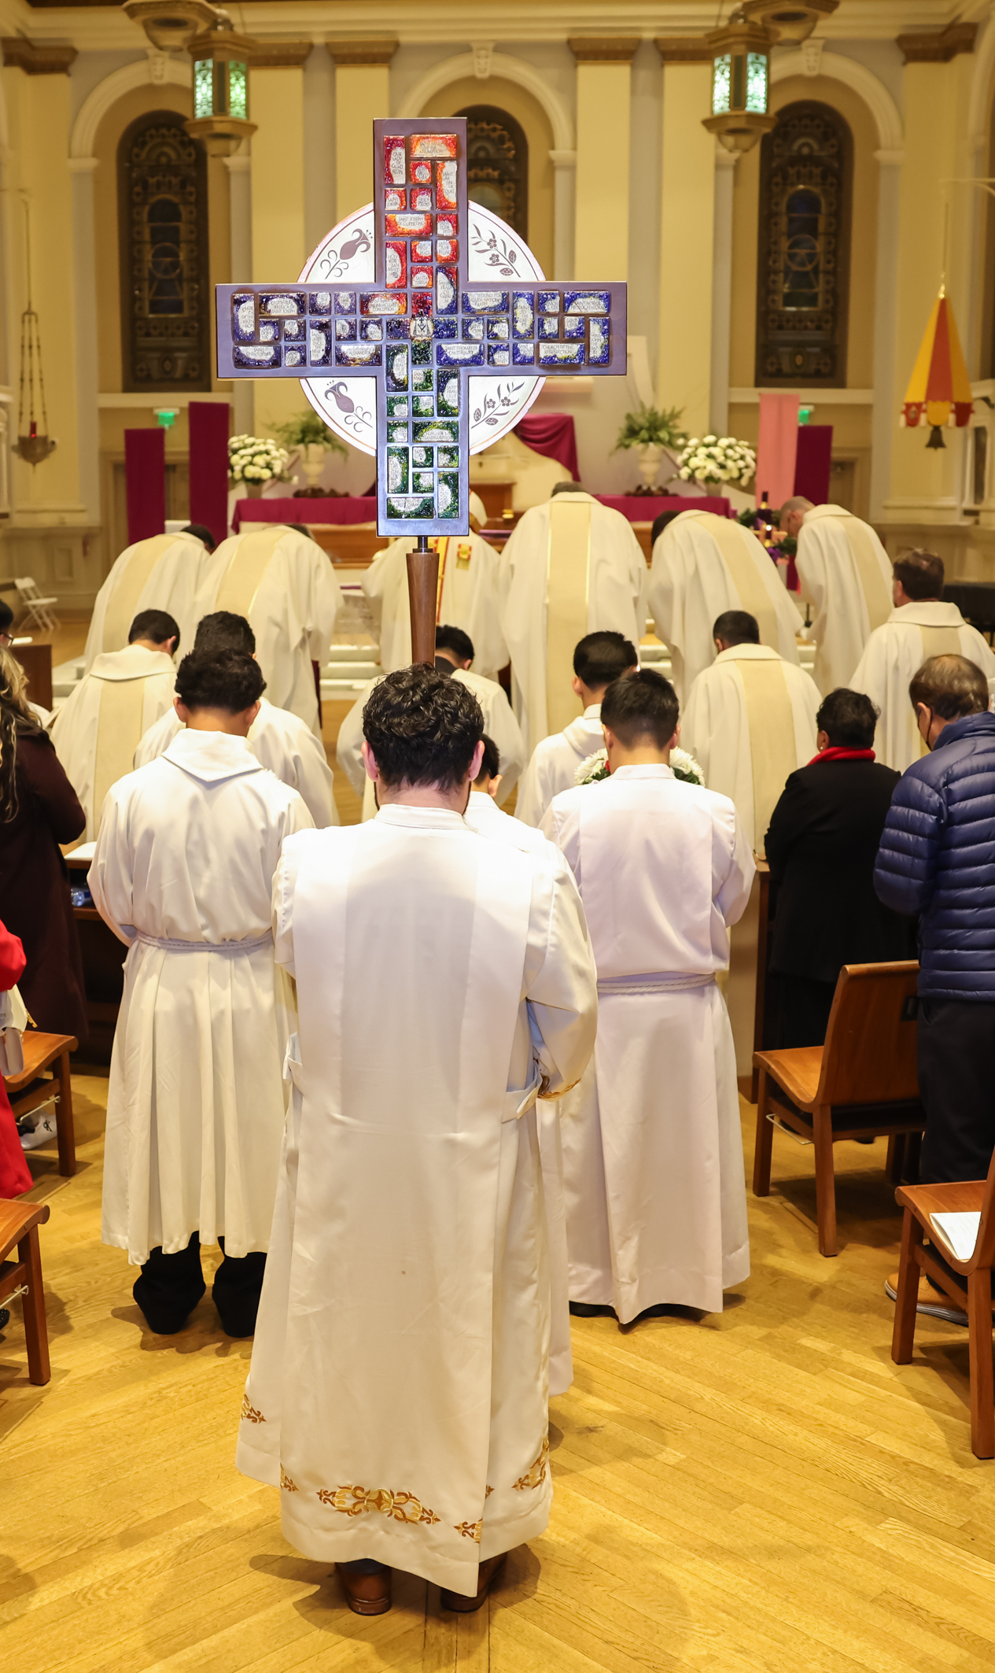

Lent 2026: Welcoming & Participation
Parts of the Mass
  Gathering, Penitential Act, Gloria (when used), Collect, Liturgical Year
Pastoral Focus
  The role of the assembly - active and conscious participation through preparation, responding and singing (music is not a performance)
  Being formed as one body, welcoming all and asking for mercy.
  By walking through the seasons of the liturgical year to helps us understand and deepen the different “seasons” of our lives
  Lay Minister Training Focus
Sacristan, Mass Coordinator, Art and Environment, Altar Server Coordinators, Usher, Hospitality Minister, Music Directors
Date: Rollout begins on the First Sunday of Lent 2026
Unified practices in all Masses by July 1, 2026
Notes:
---
The first phase during Lent 2026 sets the tone for the entire renewal process. Its primary focus is on deepening Eucharistic devotion and fostering a spirit of penitence. Parishes will receive catechetical materials emphasizing the theology of the Eucharist and the importance of active participation in Mass. Initiatives include promoting Eucharistic Adoration, enhancing the quality of homilies, and encouraging personal and communal prayer practices. Clergy workshops will address preaching during penitential seasons, while lay ministers will be trained to support liturgical preparation and execution. Communication strategies will highlight the spiritual significance of Lent, using diocesan channels to share reflections, video messages, and parish success stories. This phase also introduces the concept of renewal as a journey, inviting parishioners to commit to ongoing formation. By grounding the process in prayer and sacramental life, Lent 2026 establishes a strong foundation for subsequent phases, ensuring that renewal is not merely procedural but deeply spiritual.
Image source: Microsoft 365 content library

Slide 8
Key Dates for phase 1 – full implementation July 1st, 2026
February 24 - March 22 PARISH LITURGICAL LEADER WORKSHOPS
March 22 - April 10 VOLUNTEER CATECHESIS AND PREPARATION FOR PARISHIONER LAUNCH
April 12 – June 20 PARISHIONER CATECHESIS & PRACTICE

Slide 9
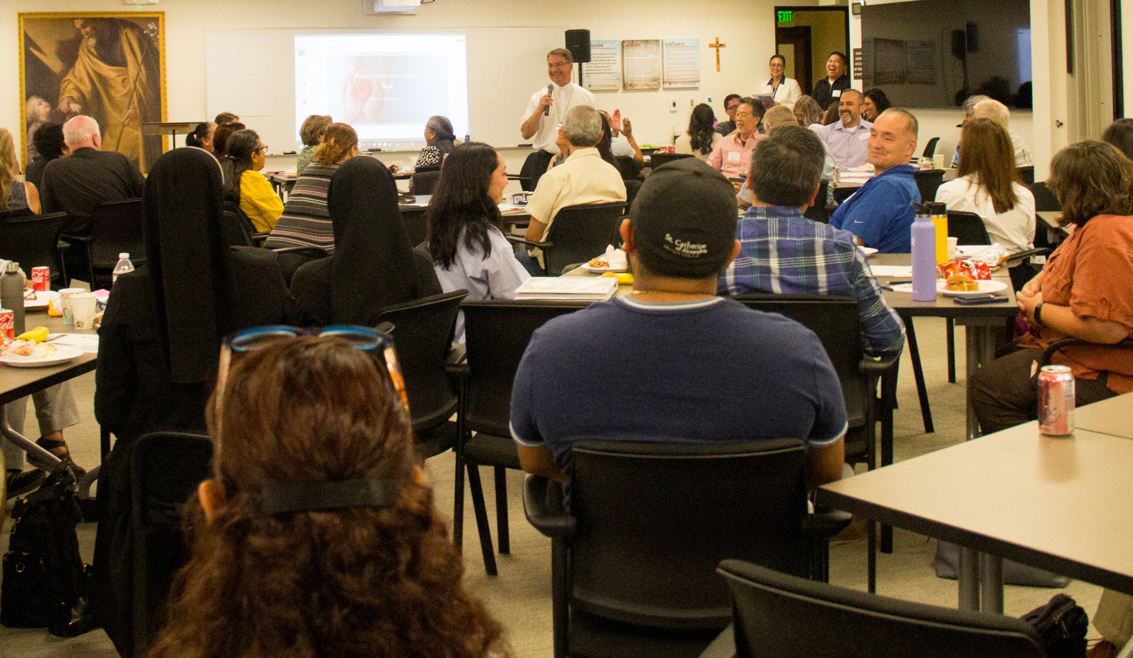
Hospitality – Usher coordinator ministry training
Hospitality-Usher prayer
Diocesan guidelines for Hospitality-Ushers
Definition of Hospitality-Ushers
Dress code
Roles of Hospitality-Ushers
Hospitality-Ushers guide
Additional Information
  Resources
  Glossary
Notes:
---
The first phase during Lent 2026 sets the tone for the entire renewal process. Its primary focus is on deepening Eucharistic devotion and fostering a spirit of penitence. Parishes will receive catechetical materials emphasizing the theology of the Eucharist and the importance of active participation in Mass. Initiatives include promoting Eucharistic Adoration, enhancing the quality of homilies, and encouraging personal and communal prayer practices. Clergy workshops will address preaching during penitential seasons, while lay ministers will be trained to support liturgical preparation and execution. Communication strategies will highlight the spiritual significance of Lent, using diocesan channels to share reflections, video messages, and parish success stories. This phase also introduces the concept of renewal as a journey, inviting parishioners to commit to ongoing formation. By grounding the process in prayer and sacramental life, Lent 2026 establishes a strong foundation for subsequent phases, ensuring that renewal is not merely procedural but deeply spiritual.
Image source: Microsoft 365 content library

Slide 10
ACTIVITY
Diocesan Guidelines For Hospitality-Ushers
When I entered your house, you did not give me water for my feet, but she has bathed them with her tears and wiped them with her hair. You did not give me a kiss, but she has not ceased kissing my feet since the time I entered. You did not anoint my head with oil, but she anointed my feet with ointment. So, I tell you, her many sins have been forgiven; hence, she has shown great love. (Luke 7: 44b-47a)
Hospitality Ministers, Ushers or Greeters serve as the “first face” of the parish, ensuring all who enter feel welcomed, safe, and ready for worship. This ministry is rooted in the Christian call to welcome one another as Christ has welcomed us.
An understanding of the liturgy is vital for Hospitality Ministers, particularly their role as liturgical ministers, knowing about the sections of the General Instruction of the Roman Missal that involve them, and how they can support the presider and other ministers as needed to ensure the smooth flow of the liturgy. It is also vital that Hospitality Ministers have an expansive understanding of what being welcoming and hospitable involves. The ministry of Hospitality is more than saying “hi” to people and taking up the collection. Hospitality Ministers get to know the people of the Parish and anticipate their needs.
Notes:
“This is not a standalone initiative. It’s one strand of how we live the pastoral plan—specifically the priority of Worship.”

Slide 11
ACTIVITY
Diocesan Guidelines for
Ushers, Hospitality Ministers
Hospitality Ministers may:
Assist others and model appropriate postures and participation in worship during the Mass
Need to support those who are physically unable to stand or kneel how to reverently participate in each part of the Mass
May be involved in inviting members of the Assembly to participate in carrying the cross in procession during Lent or Advent candles during Advent.
Will need to ensure that whatever is needed for the entrance procession is available at the back of the Church.
Notes:
“This is not a standalone initiative. It’s one strand of how we live the pastoral plan—specifically the priority of Worship.”

Slide 12
ACTIVITY
Serving as an Usher, Hospitality Minister
What Ushers, Hospitality Ministers Need to Know
Liturgy Knowledge: An understanding of the basic parts and flow of the Mass is essential so they can assist as needed during the liturgy.
Spiritual Preparation: Their service must be an extension of their own prayer life. They should be prepared spiritually to encounter Christ in those they meet and serve.
Emergency Protocols: They must know parish-specific safety plans, emergency contact information, such as parish phone numbers and addresses for the church and parish office, and where all medical supplies are stored.
Notes:
“This is not a standalone initiative. It’s one strand of how we live the pastoral plan—specifically the priority of Worship.”

Slide 13
ACTIVITY
Serving as an Usher, Hospitality Minister
What Ushers, Hospitality Ministers Need to Know- continued…
Parish Information: Ministers should be familiar with Mass times, the location of restrooms, and upcoming parish events to act as a resource for others.
Demeanor & Attire: A friendly, professional attitude is key. They should dress in “Sunday Best” to be easily recognizable and to reflect the dignity of the ministry. They may wear a name badge (with the name of the parish).
Full Participation: Despite their duties, they remain part of the worshipping community and are to model active participation in singing and prayer.
Notes:
“This is not a standalone initiative. It’s one strand of how we live the pastoral plan—specifically the priority of Worship.”

Slide 14
ACTIVITY
Serving as an Usher, Hospitality Minister
Other:
  Know the layout of your Parish’s Physical Plant
  Know the Parking Rules
  Know the Interior Layout of the Church (see Glossary)
  Know your Parish Staff
  Know Your Responsibilities in Protecting God’s Children and Vulnerable Adults Program
Notes:
“This is not a standalone initiative. It’s one strand of how we live the pastoral plan—specifically the priority of Worship.”

Slide 15
ACTIVITY
Serving as an Usher, Hospitality Minister
Skills to Develop
  Attentiveness
  Effective Communication
  Crowd Control
  Dealing with Difficult People
Notes:
“This is not a standalone initiative. It’s one strand of how we live the pastoral plan—specifically the priority of Worship.”

Slide 16
ACTIVITY
Hospitality - Ushers
In the body of Christ there exists a wonderful variety of Ministries, which are especially evident when we gather around the altar to worship God. By virtue of our baptism in Christ some of us are called to serve as ministers of the liturgical assembly: … Ushers provide welcome and dignified order to the celebration …
- Book of Blessings, 1858
Notes:
“This is not a standalone initiative. It’s one strand of how we live the pastoral plan—specifically the priority of Worship.”

Slide 17
ACTIVITY
Definition Of Hospitality - Ushers
Whether you see yourself as an usher, greeter or hospitality minister Your ministry is to help people participate at Mass.
Your responsibilities may be limited to finding seats for people and taking up the collection, or you may be a goodwill ambassador but remember… You come to church first to worship, and then to serve. In your ministry you help others worship too.
The more you understand how the parts of the Mass fit together, the better you will pray at church and the better you will serve those who meet you there.
Notes:
“This is not a standalone initiative. It’s one strand of how we live the pastoral plan—specifically the priority of Worship.”

Slide 18
ACTIVITY
Dress Code
Roles
Dress in clean, neat and appropriate
Shows respect for yourself and for your role in the liturgical life of the Church
Parish Dress code
Welcoming & Greeting
Seating Assistance
Emergency Management
Encourage Active Participation in the Liturgy
Cross-Bearer
Book-Bearer
Candle-Bearer
Bells
Prepre the Altar
Incensor (Thurible)
Notes:
“This is not a standalone initiative. It’s one strand of how we live the pastoral plan—specifically the priority of Worship.”

Slide 19
ACTIVITY
Hospitality – Usher Responsibilities
Before the Liturgy
Arrival Time
Appearance – Dress Code
Appearance of the Entryways, Gathering Space, and Worship Space
Indoor Areas
Restrooms
Reserved Seating
Temperature
Notes:
“This is not a standalone initiative. It’s one strand of how we live the pastoral plan—specifically the priority of Worship.”

Slide 20
ACTIVITY
Hospitality – Usher Responsibilities
As the Assembly Gathers - invite people into our spiritual home and care for them while they are present
Know your Station – indoor vs. outdoor
Welcoming the People
  Supplies needed for the elderly, disabled, and newcomers to worship safely in our community
  Assist elderly or disabled using the restroom. Having a supply of Depends and disposable cover-ups will help them preserve their dignity.
  People may become ill or faint during Mass. Bottled water and a disposable blanket to keep them warm will help keep them comfortable until emergency services arrive.
  A nursing mom may need a discrete place to feed her child. Having spare baby blankets available in case of a need would be a kindness that would make her feel more comfortable.
Notes:
“This is not a standalone initiative. It’s one strand of how we live the pastoral plan—specifically the priority of Worship.”

Slide 21
ACTIVITY
Hospitality – Usher Responsibilities
As the Assembly Gathers – continued…
  Answer Questions to those that are new and existing parishioners
  Distribute Worship Aids or other Items Needed for Full Participation in the Liturgy
  Consider the needs of people with disabilities
  Safety protocols
Notes:
“This is not a standalone initiative. It’s one strand of how we live the pastoral plan—specifically the priority of Worship.”

Slide 22
ACTIVITY
Hospitality – Usher Responsibilities
As the Assembly Gathers
Seat People
Latecomers
Overflow Seating
Help members of the community to actively engage in the liturgy. Inviting people to carry the Gifts of Bread and Wine
Notes:
“This is not a standalone initiative. It’s one strand of how we live the pastoral plan—specifically the priority of Worship.”

Slide 23
ACTIVITY
Hospitality – Usher Responsibilities
Special Circumstances
Dealing with Disruptions
Be Compassionate when Disruptions Occur
  Crying Children
  Disruptive Adults
Responding in Emergencies
Medical Emergencies
Natural Disasters, Fire
Violence
Notes:
“This is not a standalone initiative. It’s one strand of how we live the pastoral plan—specifically the priority of Worship.”

Slide 24

Small Group Discussion
In what way do you see hospitality ministry as important?
How can you become the best usher or greeter you can be?
Notes:
---
The third phase during Lent and Easter 2027 centers on the Paschal Mystery, the heart of Christian faith. Catechetical programs will explore sacramental theology, focusing on Baptism, Eucharist, and the Triduum. Parishes will be encouraged to plan vibrant celebrations of Holy Week, incorporating traditional rites with pastoral sensitivity. Clergy and liturgical leaders will receive advanced training on presiding at complex liturgies, while music ministers will prepare repertoires that reflect the solemnity and joy of the season. Communication efforts will include diocesan-wide video messages, parish-level workshops, and digital resources for families. This phase also emphasizes mystagogical catechesis, helping parishioners reflect on the meaning of the sacraments they celebrate. By immersing the faithful in the Paschal Mystery, Lent/Easter 2027 seeks to renew not only liturgical practice but also the spiritual life of the entire diocesan community.
Image source: Microsoft 365 content library

Slide 25
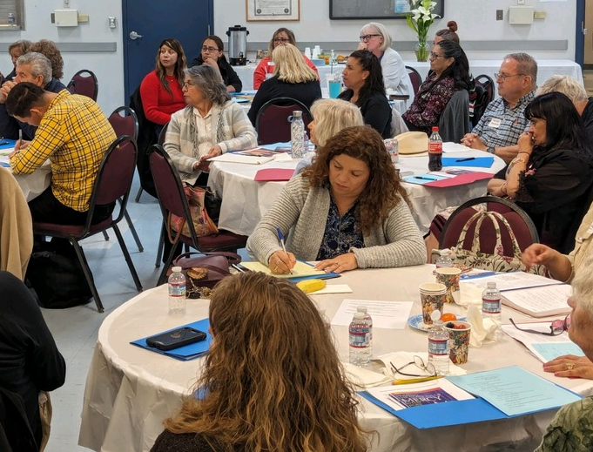
ACTIVITY
Reflection
Write down one thing you learned and one action that you will take to support spirit-filled liturgies.
Notes:
“This is not a standalone initiative. It’s one strand of how we live the pastoral plan—specifically the priority of Worship.”

Slide 26
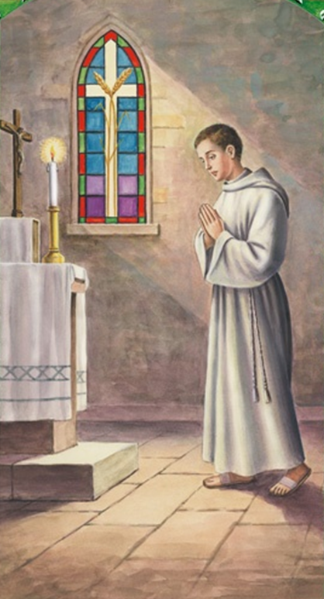
ACTIVITY
Altar Server’s Prayer
Loving Father, Creator of the Universe,
You call Your people to worship,
to be with You and with one another at Mass.
I thank You for having called me
to assist others in their prayer to You.
May I be worthy of the trust placed in me
and through my example and service,
bring others closer to You.
I ask this in the Name of our Lord Jesus Christ,
Who is Lord for ever and ever. AMEN.
St. John Berchmans, patron of Altar Servers, pray for me as I now undertake my ministry of serving at the Lord’s altar.
Notes:
“This is not a standalone initiative. It’s one strand of how we live the pastoral plan—specifically the priority of Worship.”

Slide 27
ADDITIONAL INFORMATION

Slide 28
Reference materials
GENERAL INSTRUCTION OF THE ROMAN MISSAL
  Published as part of the 3rd Edition of the Roman Missal (2010)
  Booklet published by LTP (Liturgy Training Publications)
  USCCB website URL:
    English: https://www.usccb.org/prayer-and-worship/the-mass/general-instruction-of-the-roman-missal
    Spanish: Institucion General del Misal Romano https://www.usccb.org/es/prayer-and-worship/the-mass/general-instruction-of-the-roman-missal
Guide for Ushers and Greeters, by Karie Ferrell and Paul Turner
  Booklet published by LTP (Liturgy Training Publications), 2008
  Part of the The Liturgical Ministry Series

Slide 29
The Church Building - Glossary
The Nave- The people who come for worship take their places in the nave. It is the place where they assemble.
The Sanctuary- an elevated areas separated from the nave by its elevation or its ornamentation ª. It holds the primary furnishings needed for Mass: the altar, the ambo and the chair.
The Altar - resembles a table and should be the center of attention ^{b}
The Ambo – The Word of God is proclaimed from the ambo, which resembles a lectern or pulpit ^{c}. It should be large enough to accommodate the Book of Gospels. The responsorial psalm and the prayer of the faithful are sung or read from the ambo.
GIRM: a-295; b-296; c-309

Slide 30
The Church Building - Glossary
The Chair – the priest who celebrates the Mass has his own place to sit ^{d}. His chair has the same function as the head of the dining room table
Other Seating – chair for the deacon next to the priest; chairs for altar servers or other ministers should be in the sanctuary but be less prominent
Cross and Candles – the physical relationship between the altar and the cross indicates the meaning of the actions on the altar ^{e}. The candles are a sign of light, reverence and festivity ^{f}.
Vestments and Vessels – Clergy wear colors that announce the season, feast or occasion being celebrated. Vestments and vessels should be clean, beautiful and functional ^{g}.
GIRM: d-310; e-117,122, 308; f-307; g-327-347

Slide 31
The Church Building - Glossary
Credence Table – holds the items needed for Mass and sits near a sanctuary wall.
The Tabernacle – the consecrated Eucharistic bread is kept under lock and key in the tabernacle ^{h}.
The Font – it is the place for baptism and should be suitable for both immersion and pouring
The Ambry – the area where the sacred oils are reserved
The Narthex – the gathering area inside the main exterior doors of the church
The Sacristy – area for the vesting of ministers and for the storage and cleaning of vessels
GIRM: h-314-315;

Slide 32
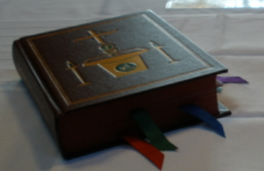
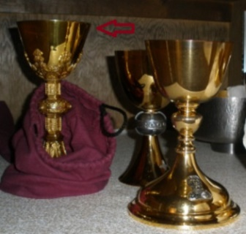
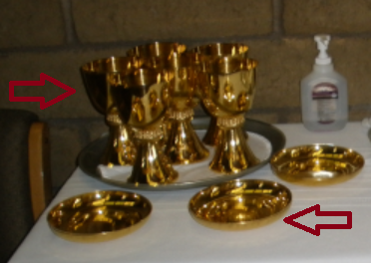
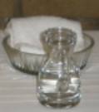
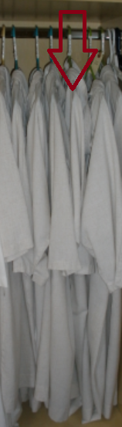
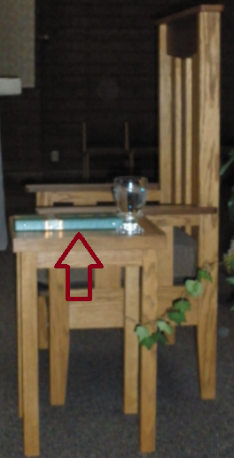
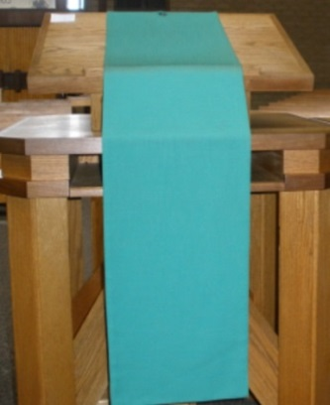
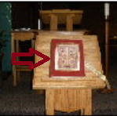
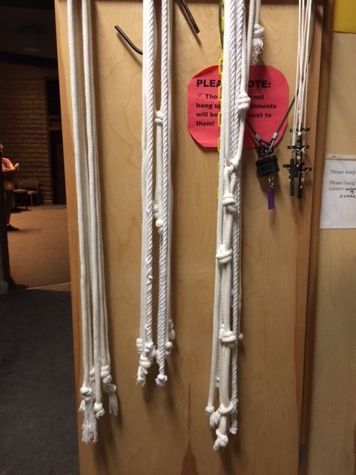
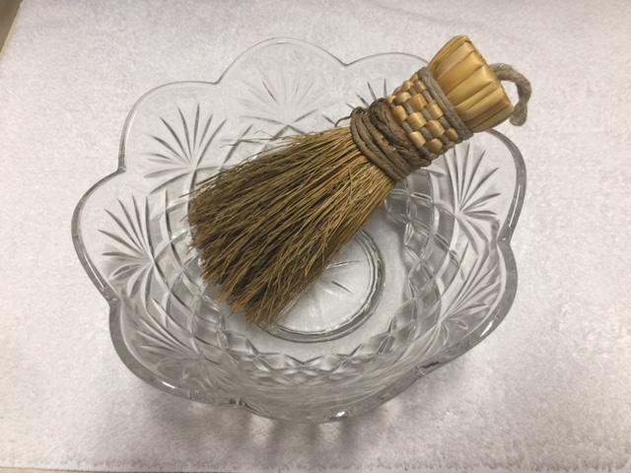
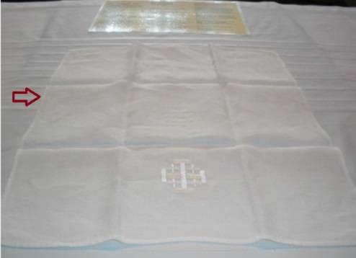
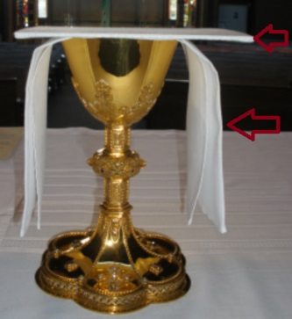
Items and Vessels Used During Mass
1
2
3
Roman Missal
Presider’s Chalice
Communion Cups & Bowls
Water basin & towel Water cruet
Gospel
Alb
Presider’s Binder
Ambo
Cincture
Glass bowl & Aspergillum (for holy water)
Corporal
Purificator
4
6
7
8
5
9
10
11
12
Notes:
---
The final phase in Fall 2027 focuses on evaluating the impact of the renewal and integrating best practices into parish life. Diocesan leadership will conduct surveys and listening sessions to gather feedback from clergy, ministers, and parishioners. Metrics will include participation rates, quality of liturgical celebrations, and effectiveness of catechetical programs. Based on this data, the diocese will develop guidelines for sustaining renewal efforts, ensuring that improvements become permanent features of parish life. This phase also addresses challenges encountered during the process, offering solutions and additional resources where needed. Communication strategies will celebrate successes, share testimonies, and outline next steps for ongoing formation. By concluding with evaluation and integration, the plan ensures that liturgical renewal is not a temporary initiative but a lasting transformation rooted in the Church’s mission.
Image source: Microsoft 365 content library

