Slide 1
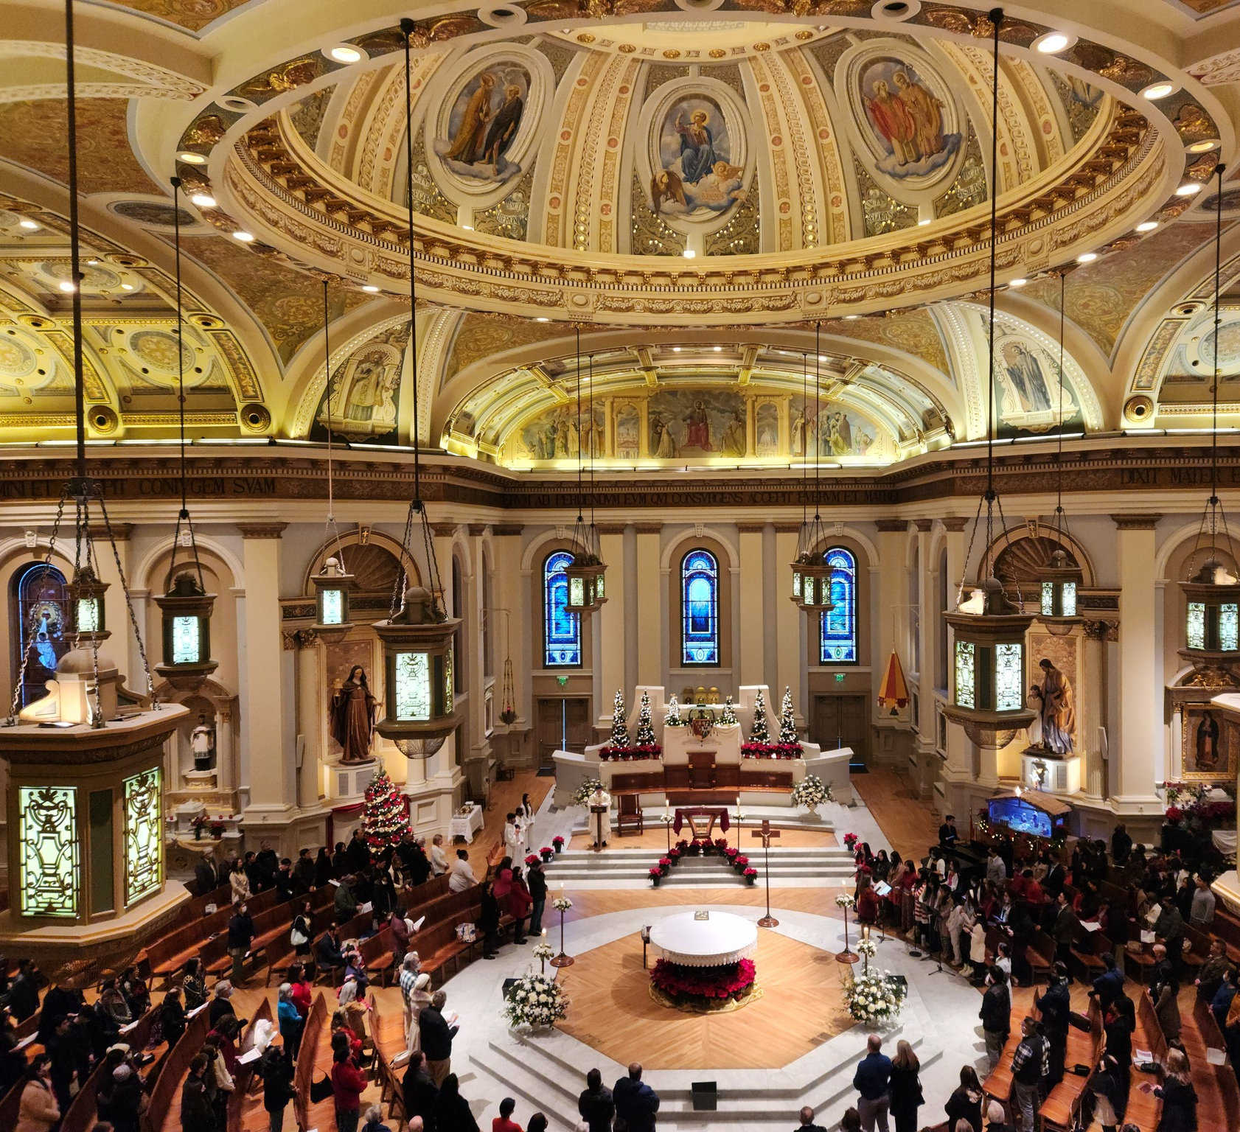
Liturgical Renewal ALTAR SERVER MINISTRY WORKSHOP
Renewed at the Table of the Lord
February , 2026
Notes:
--- Image source: Microsoft 365 content library

Slide 2
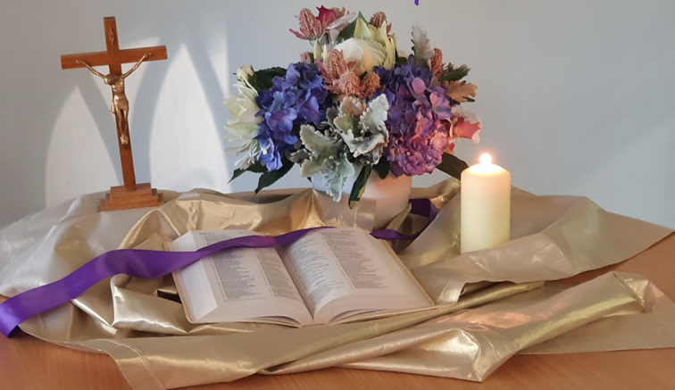
ACTIVITY
Opening Prayer
Scripture: Matthew 20: 25-28
But Jesus summoned them and said, “You know that the rulers of the Gentiles lord it over them, and the great ones make their authority over them felt.
But it shall not be so among you. Rather, whoever wishes to be great among you shall be your servant; whoever wishes to be first among you shall be your slave.
Just so, the Son of Man did not come to be served but to serve and to give his life as a ransom* for many.”
Notes:
“This is not a standalone initiative. It’s one strand of how we live the pastoral plan—specifically the priority of Worship.”

Slide 3
ACTIVITY
Activity
Share one part of the Mass that nourishes your faith?
Notes:
“This is not a standalone initiative. It’s one strand of how we live the pastoral plan—specifically the priority of Worship.”

Slide 4
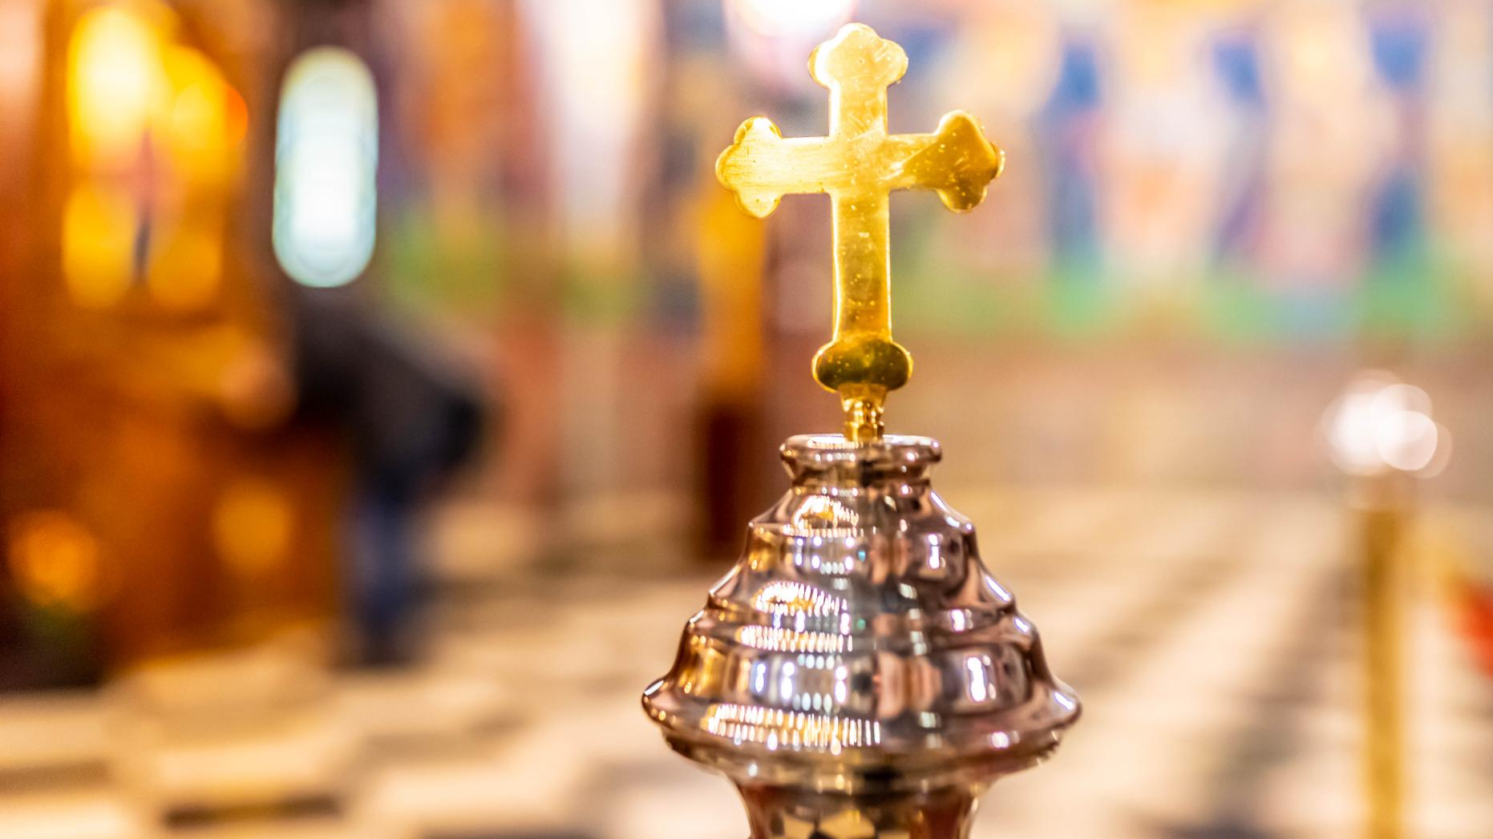
Liturgical renewal is a diocesan effort to deepen spiritual renewal by helping our people more fully, consciously, and actively participate in the Mass—the source and summit of our life together.
Why Liturgical Renewal — in one sentence
Notes:
--- The diocesan initiative for liturgical renewal aims to deepen the spiritual life of parishes by fostering authentic participation in the sacred liturgy over a two-year period. This plan is rooted in the Church’s call for ongoing renewal, emphasizing reverence, beauty, and active engagement with the Eucharist as the source and summit of Christian life. The objectives include strengthening catechesis on liturgical theology, enhancing the quality of celebrations, and equipping clergy and lay ministers with resources to lead renewal efforts effectively. By focusing on seasonal phases aligned with the liturgical calendar, the plan ensures that renewal is not a one-time event but a sustained journey of formation and transformation. Key goals include improving homiletic quality, promoting sacred music that reflects the Church’s tradition, and fostering a culture of prayerful preparation among ministers and congregations. This vision also addresses pastoral challenges such as balancing tradition with accessibility, ensuring inclusivity while maintaining doctrinal integrity, and responding to cultural diversity within the diocese. Ultimately, the renewal seeks to inspire a deeper encounter with Christ through the liturgy, strengthening parish identity and unity across communities. Image source: Microsoft 365 content library

Slide 5
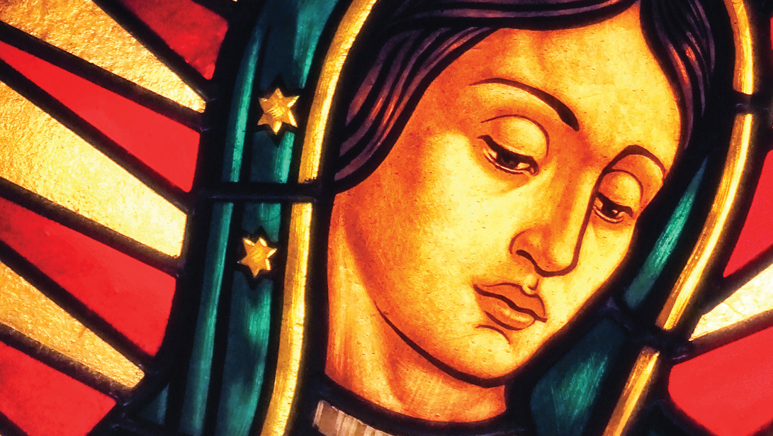
Spiritual and Pastoral Frames
EUCHARIST – The Eucharist as the “source and summit” of Christian life
ASSEMBLY – Vatican II called all members of the assembly to actively participate in the liturgy
UNITY – Our Lady of Guadalupe gathers us as ONE family leads us to Christ
Notes:
The diocesan initiative for liturgical renewal aims to deepen the spiritual life of parishes by fostering authentic participation in the sacred liturgy over a two-year period. This plan is rooted in the Church’s call for ongoing renewal, emphasizing reverence, beauty, and active engagement with the Eucharist as the source and summit of Christian life. The objectives include strengthening catechesis on liturgical theology, enhancing the quality of celebrations, and equipping clergy and lay ministers with resources to lead renewal efforts effectively. By focusing on seasonal phases aligned with the liturgical calendar, the plan ensures that renewal is not a one-time event but a sustained journey of formation and transformation. Key goals include improving homiletic quality, promoting sacred music that reflects the Church’s tradition, and fostering a culture of prayerful preparation among ministers and congregations. This vision also addresses pastoral challenges such as balancing tradition with accessibility, ensuring inclusivity while maintaining doctrinal integrity, and responding to cultural diversity within the diocese. Ultimately, the renewal seeks to inspire a deeper encounter with Christ through the liturgy, strengthening parish identity and unity across communities. Image source: Microsoft 365 content library

Slide 6
TIMELINE FOR LITURGICAL RENEWAL
TIMELINE FOR LITURGICAL RENEWAL
Lent 2026
Introductory Rite
Fall 2026
Liturgy of the Word
Lent/Easter 2027
Liturgy of Eucharist
Fall 2027
Communion and Concluding Rites
Notes:
The two-year arc is structured around four major phases corresponding to key liturgical seasons: Lent 2026, Fall 2026, Lent/Easter 2027, and Fall 2027. Each phase builds upon the previous, creating a rhythm of catechesis, formation, and implementation. Lent 2026 initiates the renewal with a focus on penitential practices and Eucharistic devotion, encouraging parishes to adopt resources for deepening prayer and sacramental life. Fall 2026 emphasizes community engagement and the enrichment of Sunday worship, introducing training modules for music ministers and lectors. Lent/Easter 2027 centers on the Paschal Mystery, integrating catechetical series on sacramental theology and fostering vibrant celebrations of the Triduum. Finally, Fall 2027 consolidates the renewal by evaluating progress, addressing challenges, and embedding best practices into parish life. A timeline graphic will illustrate these phases, highlighting key milestones such as clergy workshops, parish toolkit distribution, and diocesan-wide liturgical celebrations. This phased approach ensures gradual implementation, allowing time for feedback and adaptation while maintaining momentum. By aligning with the liturgical calendar, the plan leverages natural opportunities for spiritual renewal and catechesis, making the process both organic and impactful.

Slide 7
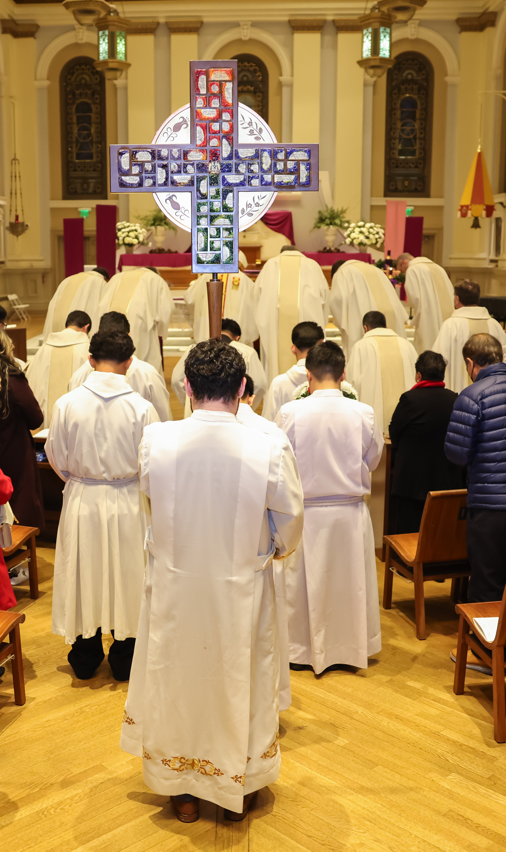

Lent 2026: Welcoming & Participation
Parts of the Mass
Gathering, Penitential Act, Gloria (when used), Collect, Liturgical Year
Pastoral Focus
The role of the assembly - active and conscious participation through preparation, responding and singing (music is not a performance)
Being formed as one body, welcoming all and asking for mercy.
By walking through the seasons of the liturgical year to helps us understand and deepen the different “seasons” of our lives
Lay Minister Training Focus
Sacristan, Mass Coordinator, Art and Environment, Altar Server Coordinators, Usher, Greeter, Music Directors
Date: Rollout begins on the First Sunday of Lent 2026
Unified practices in all Masses by July 1st, 2026
Notes:
--- The first phase during Lent 2026 sets the tone for the entire renewal process. Its primary focus is on deepening Eucharistic devotion and fostering a spirit of penitence. Parishes will receive catechetical materials emphasizing the theology of the Eucharist and the importance of active participation in Mass. Initiatives include promoting Eucharistic Adoration, enhancing the quality of homilies, and encouraging personal and communal prayer practices. Clergy workshops will address preaching during penitential seasons, while lay ministers will be trained to support liturgical preparation and execution. Communication strategies will highlight the spiritual significance of Lent, using diocesan channels to share reflections, video messages, and parish success stories. This phase also introduces the concept of renewal as a journey, inviting parishioners to commit to ongoing formation. By grounding the process in prayer and sacramental life, Lent 2026 establishes a strong foundation for subsequent phases, ensuring that renewal is not merely procedural but deeply spiritual. Image source: Microsoft 365 content library

Slide 8
Key Dates for phase 1 – full implementation July 1st, 2026
February 24 - March 22 PARISH LITURGICAL LEADER WORKSHOPS
March 22 - April 10 VOLUNTEER CATECHESIS AND PREPARATION FOR PARISHIONER LAUNCH
April 12 – June 20 PARISHIONER CATECHESIS & PRACTICE

Slide 9
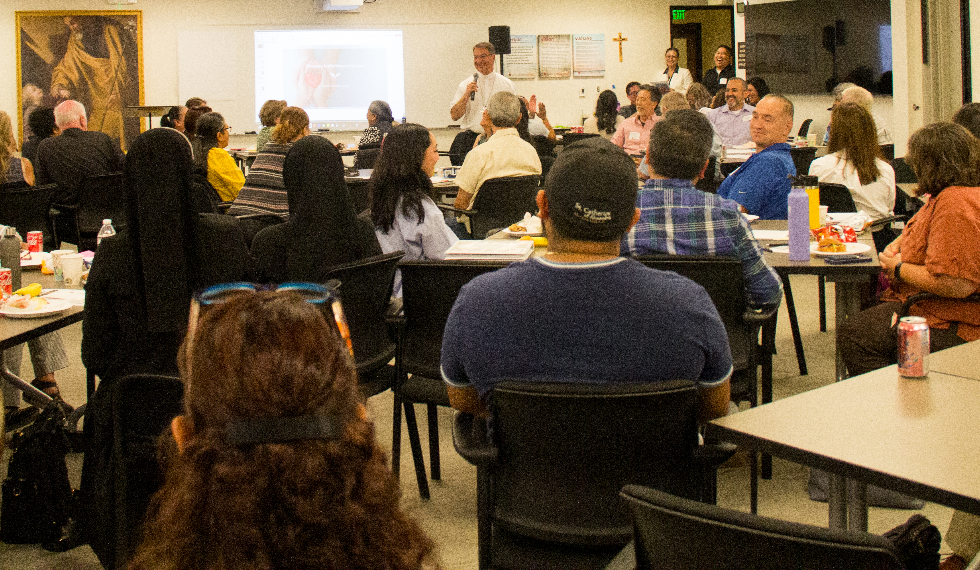
Altar server coordinator ministry training
Altar servers’ prayer
Diocesan guidelines for altar servers
Definition of altar servers
Dress code
Roles of Altar servers
Altar server guide
Things to remember
Items and Vessels used during Mass
Notes:
--- The first phase during Lent 2026 sets the tone for the entire renewal process. Its primary focus is on deepening Eucharistic devotion and fostering a spirit of penitence. Parishes will receive catechetical materials emphasizing the theology of the Eucharist and the importance of active participation in Mass. Initiatives include promoting Eucharistic Adoration, enhancing the quality of homilies, and encouraging personal and communal prayer practices. Clergy workshops will address preaching during penitential seasons, while lay ministers will be trained to support liturgical preparation and execution. Communication strategies will highlight the spiritual significance of Lent, using diocesan channels to share reflections, video messages, and parish success stories. This phase also introduces the concept of renewal as a journey, inviting parishioners to commit to ongoing formation. By grounding the process in prayer and sacramental life, Lent 2026 establishes a strong foundation for subsequent phases, ensuring that renewal is not merely procedural but deeply spiritual. Image source: Microsoft 365 content library

Slide 10
ACTIVITY
Diocesan Guidelines For Altar Servers
The following guidelines were prepared by the Committee on the Liturgy and presented to the National Conference of Catholic Bishops for discussion at the June 1994 Special Assembly on Thursday, June 16, 1994. The suggested guidelines—which predate the Apostolic Letter motu proprio Spiritus Domini (2021), opening the instituted ministry of acolyte to women—have been slightly revised according to the third edition of the General Instruction of the Roman Missal. They may be used as a basis for developing diocesan guidelines.
Resource link: https://www.usccb.org/prayer-and-worship/the-mass/frequently-asked-questions/guidelines-for-altar-servers
Notes:
“This is not a standalone initiative. It’s one strand of how we live the pastoral plan—specifically the priority of Worship.”

Slide 11
ACTIVITY
Diocesan Guidelines For Altar Servers
The diocesan bishop may permit the liturgical functions of the instituted acolyte to be carried out by altar servers.
The term "server" should be used for those who carry out the functions of the instituted acolyte.
Servers should be mature enough to understand their responsibilities and have already received holy communion for the first time.
Servers should receive proper formation before they begin to function.
Since the role of the server is integral to the normal celebration of the Mass, at least one server should assist the priest.
Altar servers, readers, and other lay ministers may wear the alb or other suitable vesture or other appropriate or dignified clothing.
Notes:
“This is not a standalone initiative. It’s one strand of how we live the pastoral plan—specifically the priority of Worship.”

Slide 12
ACTIVITY
Diocesan Guidelines For Altar Servers
Servers carry the cross, the processional candles, hold the book for the celebrant when he is not at the altar, carry the incense and censer, present the bread, wine, and water to the priest during the preparation of the gifts or assist him when he receives the gifts from the people, wash the hands of the celebrant, assist the celebrant and deacon as necessary.
Servers respond to the prayers and dialogues of the celebrant along with the congregation.
Servers should be seated in a place from which they can easily assist the priest celebrant and deacon.
Notes:
“This is not a standalone initiative. It’s one strand of how we live the pastoral plan—specifically the priority of Worship.”

Slide 13
ACTIVITY
Diocesan Guidelines for Altar Servers
Servers may not distribute holy communion unless they have been mandated for this function by the bishop.
The Order for the Blessing of Altar Servers, Sacristans, Musicians, and Ushers (Book of Blessings, nos. 1847-1870) may be used before servers first begin to function in this ministry.
Notes:
“This is not a standalone initiative. It’s one strand of how we live the pastoral plan—specifically the priority of Worship.”

Slide 14
ACTIVITY
Definition Of Altar Servers
It is a great privilege to serve at the Altar of our God. Our loving Savior becomes present on the Altar, just as He was at the Last Supper. Therefore, servers have a solemn responsibility to do their assigned duties with dignity and reverence.
Altar Servers (boys and girls), who start after their first communion and continue for as long as we can keep them. All people of good faith are welcome, and those who think they may desire to serve are encouraged to do so. All that is required is a desire to serve at the Altar of Our Lord.
Notes:
“This is not a standalone initiative. It’s one strand of how we live the pastoral plan—specifically the priority of Worship.”

Slide 15
ACTIVITY
Dress Code
For Altar Servers
Roles
Of Altar Server
Cross Bearer
Book Bearer
Candle Bearer
Bells
Prepare the Altar
Incensor (Thurible)
Dress appropriately, including your shoes
Cross-Bearer
Book-Bearer
Candle-Bearer
Bells
Prepre the Altar
Incensor (Thurible)
Notes:
“This is not a standalone initiative. It’s one strand of how we live the pastoral plan—specifically the priority of Worship.”

Slide 16
ACTIVITY
Altar Server’s Guide
Arrive 15 to 20 minutes before Mass to vest and determine which role you will serve in.
Line in the vestibule in proper order for the entrance procession
Altar servers walk to the altar, when the celebrant bows, the altar servers bow with him.
The altar servers process to complete their role by placing the crucifix and candles where appropriate.
During the reading, the book server will hold the book for the celebrant.
During the Liturgy of the Word, the Altar Servers will listen attentively along with the community.
Notes:
“This is not a standalone initiative. It’s one strand of how we live the pastoral plan—specifically the priority of Worship.”

Slide 17
ACTIVITY
Altar Server’s Guide
The altar servers can assist the celebrant in receiving the gifts of hosts and wine to be consecrated.
Altar servers can assist by bringing a cruet of water to the celebrant when needed and washing the hands of the celebrant.
If bells are used, they are rung at Epiclesis and at the elevation of the Body and Blood of Christ.
After communion, the altar servers remove the chalice and purificator, and other items, and place them on the Credence Table, and then take their seats.
The book-server will hold the book for the celebrant during the concluding rite.
The altar servers will fulfill their role for the recessional procession.
Notes:
“This is not a standalone initiative. It’s one strand of how we live the pastoral plan—specifically the priority of Worship.”

Slide 18

Small Group Discussion
In what way do you see the ministry of altar server as important?
How can you become the best altar server you can be?
Notes:
--- The third phase during Lent and Easter 2027 centers on the Paschal Mystery, the heart of Christian faith. Catechetical programs will explore sacramental theology, focusing on Baptism, Eucharist, and the Triduum. Parishes will be encouraged to plan vibrant celebrations of Holy Week, incorporating traditional rites with pastoral sensitivity. Clergy and liturgical leaders will receive advanced training on presiding at complex liturgies, while music ministers will prepare repertoires that reflect the solemnity and joy of the season. Communication efforts will include diocesan-wide video messages, parish-level workshops, and digital resources for families. This phase also emphasizes mystagogical catechesis, helping parishioners reflect on the meaning of the sacraments they celebrate. By immersing the faithful in the Paschal Mystery, Lent/Easter 2027 seeks to renew not only liturgical practice but also the spiritual life of the entire diocesan community. Image source: Microsoft 365 content library

Slide 19
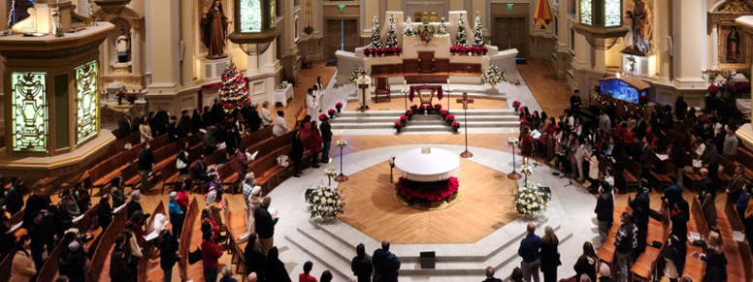
ACTIVITY
Things to Remember
Arrive at least 20 minutes before the Mass starts to get dressed.
Check in with your altar coordinator
Vest in your alb.
Know your responsibilities and perform the duties assigned during the mass in the prescribed orderly manner.
Be sure you know what you are doing and when and how to do it before Mass begins.
Notes:
“This is not a standalone initiative. It’s one strand of how we live the pastoral plan—specifically the priority of Worship.”

Slide 20
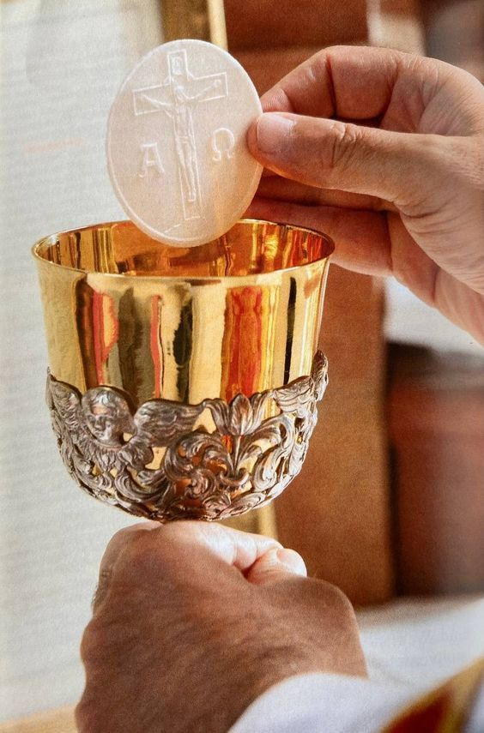
ACTIVITY
Things To Remember
Maintain a prayerful posture at all times in the Sacristy.
Be quiet and respectful when on the Altar.
Be attentive and respond immediately when the priest asks for help.
Take some time to pray before Mass, and always participate fully during Mass.
Make sure that your Alb is returned the way you found it or better.
Notes:
“This is not a standalone initiative. It’s one strand of how we live the pastoral plan—specifically the priority of Worship.”

Slide 21
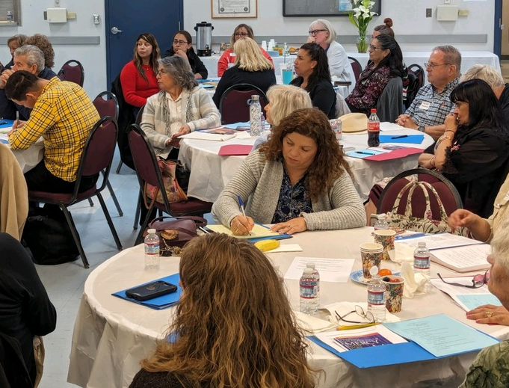
ACTIVITY
Reflection
Write down one thing you learned and one action that you will take to support spirit-filled liturgies.
Notes:
“This is not a standalone initiative. It’s one strand of how we live the pastoral plan—specifically the priority of Worship.”

Slide 22
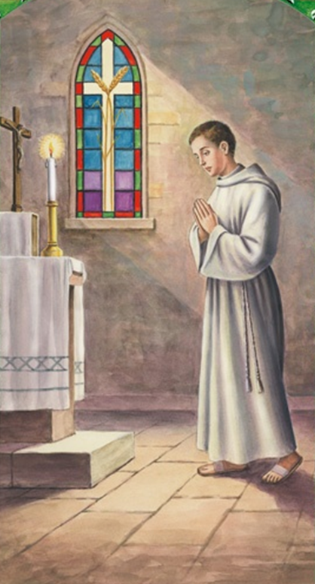
ACTIVITY
Altar Server’s Prayer
Loving Father, Creator of the Universe,
You call Your people to worship,
to be with You and with one another at Mass.
I thank You for having called me
to assist others in their prayer to You.
May I be worthy of the trust placed in me
and through my example and service,
bring others closer to You.
I ask this in the Name of our Lord Jesus Christ,
Who is Lord for ever and ever. AMEN.
St. John Berchmans, patron of Altar Servers, pray for me as I now undertake my ministry of serving at the Lord’s altar.
Notes:
“This is not a standalone initiative. It’s one strand of how we live the pastoral plan—specifically the priority of Worship.”

Slide 23
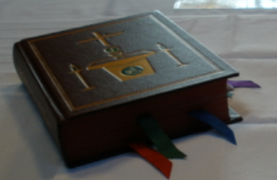
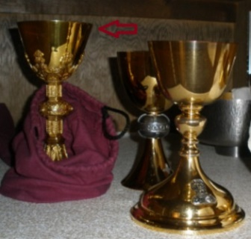
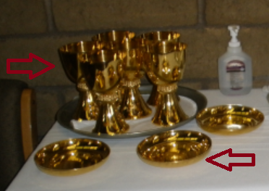
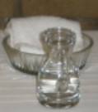
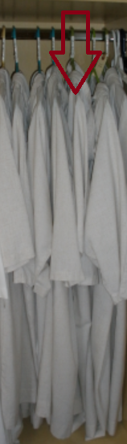
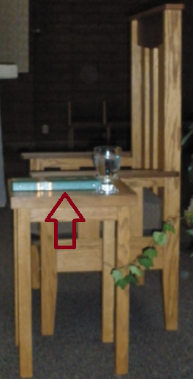
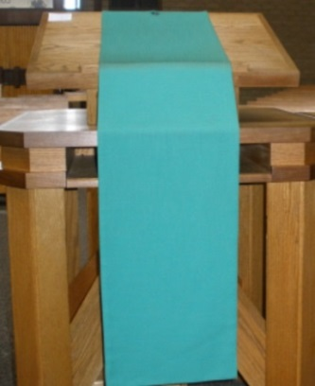
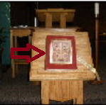
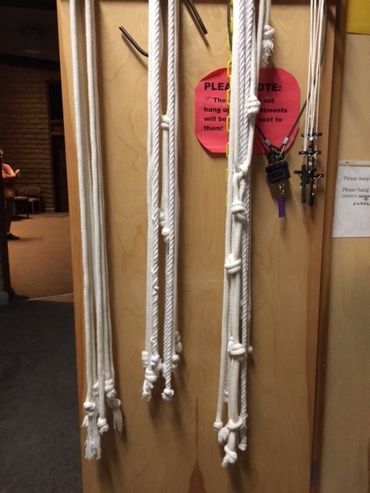
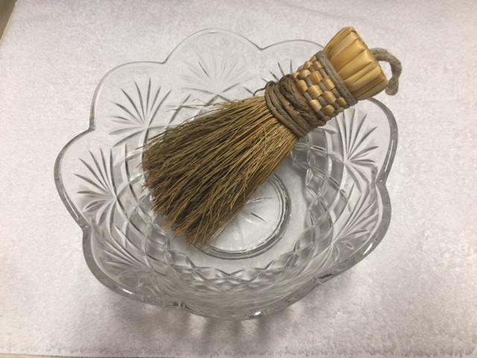
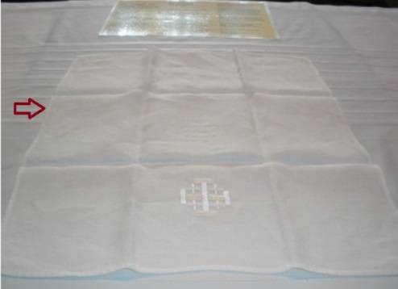
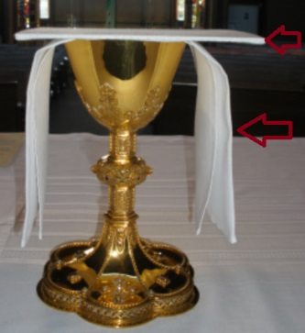
Items and Vessels Used During Mass
1
2
3
Roman Missal
Presider’s Chalice
Communion Cups & Bowls
Water basin & towel Water cruet
Gospel
Alb
Presider’s Binder
Ambo
Cincture
Glass bowl & Aspergillum (for holy water)
Purificator
Corporal
4
6
7
8
5
9
10
11
12
Notes:
--- The final phase in Fall 2027 focuses on evaluating the impact of the renewal and integrating best practices into parish life. Diocesan leadership will conduct surveys and listening sessions to gather feedback from clergy, ministers, and parishioners. Metrics will include participation rates, quality of liturgical celebrations, and effectiveness of catechetical programs. Based on this data, the diocese will develop guidelines for sustaining renewal efforts, ensuring that improvements become permanent features of parish life. This phase also addresses challenges encountered during the process, offering solutions and additional resources where needed. Communication strategies will celebrate successes, share testimonies, and outline next steps for ongoing formation. By concluding with evaluation and integration, the plan ensures that liturgical renewal is not a temporary initiative but a lasting transformation rooted in the Church’s mission. Image source: Microsoft 365 content library

